Slide 1

https://www.uni-goettingen.de/en/48115.html
Quantitative Genetics for the ‚Ideal‘ and for the ‚Inbred‘ Population.
UNPLAB-QuGen_Ch-10[GenV 0>F>1]
1

Slide 2
Sequential Number: #44
UNPLAB-QuGen_Ch-10[GenV 0>F>1]
Unless I explicitly state otherwise, images and cartoons are created using ChatGPT.
You may use this material free of charge under the terms of the CC BY license. This requires that you provide appropriate attribution to the author:
W. Link, University of Goettingen, Germany.
In a few cases, individual images, photographs, or similar material may be subject to a more restrictive Creative Commons license. Where this applies, it is explicitly indicated, and you must comply with the stated license terms for those items.
Please check the license information carefully before reuse. Responsibility for complying with the applicable license terms rests entirely with you.
2

Slide 3
You already know: Population Genetics, GxE, h², Plant Breeding Methodology.
Diversity vs. Variance; Normal Distribution and Variance; More than one trait to breed for; Qualitative vs. quantitative variation aka monogenic vs. polygenic variance; Impact of allele frequencies on variance, aka impact of selection of variance. You have seen the transition from monogenic to polygenic Segregation and Variance. The parameters of the Metric F∞ Model, mainly the additive effect ‘a’ and the dominance effect ‘d’. The parameters of the Statistical Model leading to Additive and Dominance Variance.
The impact of a, d, p on mean vale µ and additive and dominance variance of our HWE population.
This chapter is intended for those who want to experiment a bit with what they've learned so far while also delving a little deeper. There's nothing to memorize here - just enjoy it when you understand .
Algebra as introduced in this chapter:
σ²_{G} =(1+F) σ²_{A} + (1-F) σ²_{D} + 4 F D₁ + F D₂* + F (1-F) H* With 2 alleles per locus, H* = σ²_{D}
σ²_{G} =(1+F) σ²_{A} + (1+F)(1-F) σ²_{D} + 4 F D₁ + F D₂*
σ²∞(A) = 2pqa² = σ²_{A} + 2D₁ + ½ D₂* = half the genetic variance at F=1
σ²∞(D) = 2pqd² - (2pqd)²
ω∞(A;D) = 2pqad(q-p).
With F=0: σ²_{G} = σ²_{A} +σ²_{D}
With F=1: σ²_{G} = σ²∞(A) + σ²∞(D) + 2 ∙ω∞(A;D)
3

Slide 4

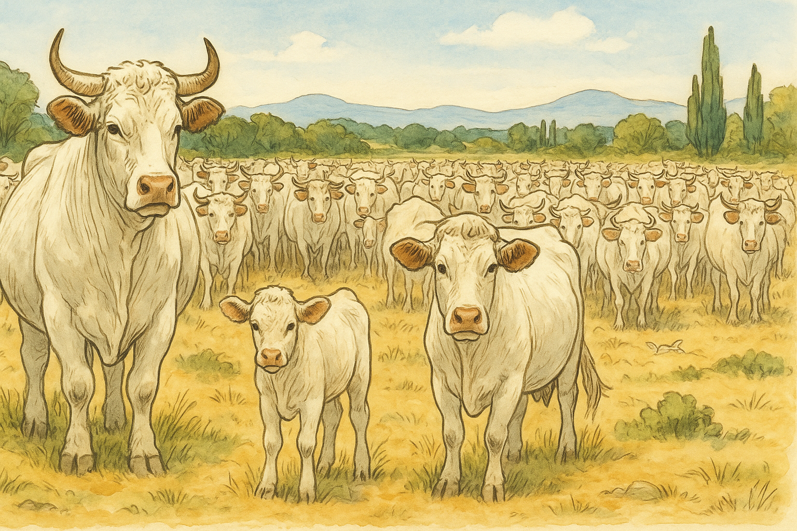
Remember! The so-called Reference Population is a population with N=∞ members, Random Mating hence non-inbred, in single-locus HWE and in generalized HWE, hence with LD=0. It is diploid and for us plant breeders this population it is annual ...
... though animal breeder may think differently. The individuals (plants) are self-compatible yet due to N_{e}=∞, probability of selfing is P=1/∞=0. The probability of mating between relatives is as well zero. The population itself is immortal; it reproduces without Selection, Mutation, Migration, Drift.
Default Quantitative Genetic parameters are defined with reference to this ... Reference Population. This population does not need to exist in reality (obviously it cannot exist), it is nevertheless needed as concept of thinking and reasoning.
In the wording of famous Rex Bernardo (2020. ISBN 978-0-9720724-3-4): “Populations in Hardy-Weinberg equilibrium represent idealized populations. Much of the theory and methodology in quantitative genetics has been formulated on the assumption that the reference population is in Hardy-Weinberg equilibrium. ...”
4

Slide 5
From a representative sample of HWE-members (F=0, i.e. S0; meaning ‘not-yet-selfed’), we produce their progenies - by DH or via self-fertilization-until-homozygosity (F=1).
HWE Population, indicated by this sunflower drawing
We ask: What is the connection between performance and variance of the individuals in HWE and the variance from segregation within their thus-derived DH-bulks (or* F∞ bulks)?
S0
F∞
S0
F∞
S0
S0
F∞
F∞
S0
F∞
S0
S0
F∞
F∞
*of course you see that there is no genetic difference between these DH bulks and these F∞ bulks – because LD=0).
5

Slide 6
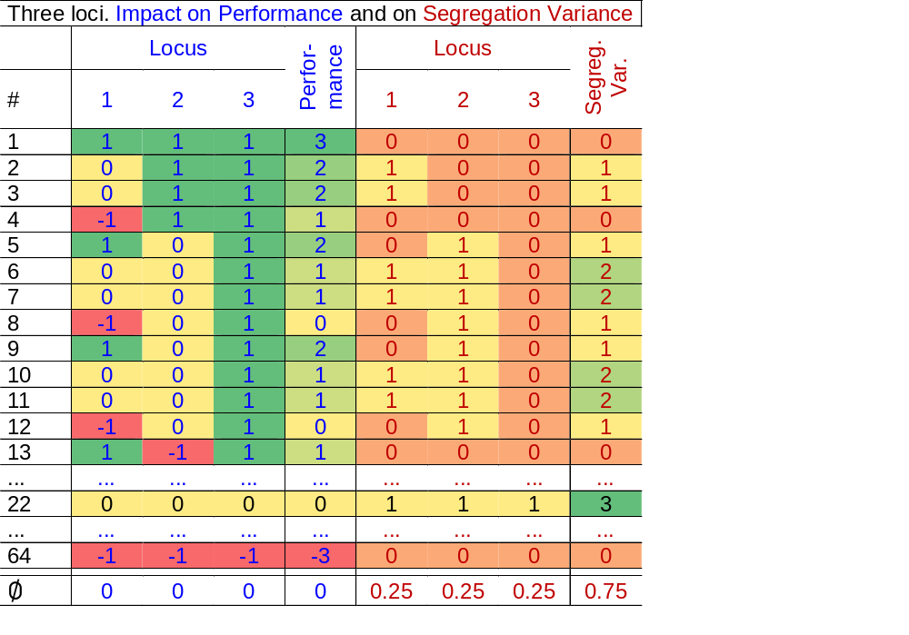

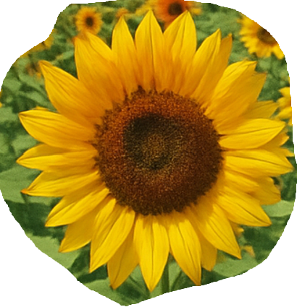
64 genotypes, 3 loci, p=q=0.5, a=1; d=0. Genotype #1 is [A1A1|B1B1|C1C1] with impact on trait expres-sion (performance) of 3. No segregation. #22 is [A1A2|B1B2|C1C2] hence triple heterozygous, perfor-mance 0 and maximum segregation. #64 is triple homozygous for ‚bad‘ allele.
The correlation between loci is zero, this is an idealized setting. The extreme-performing genotypes (#1; #64) segregate zero. Most average-performing types segregate, some even much.
6

Slide 7
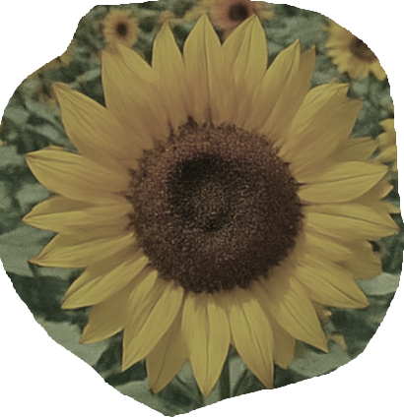

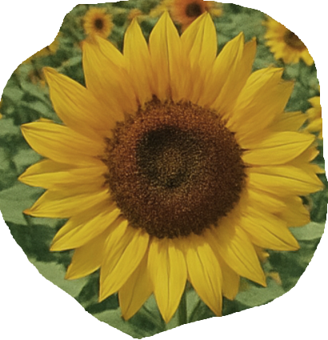
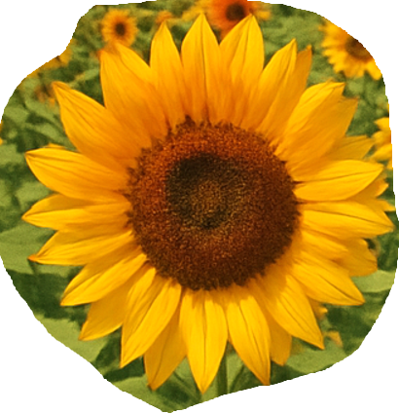
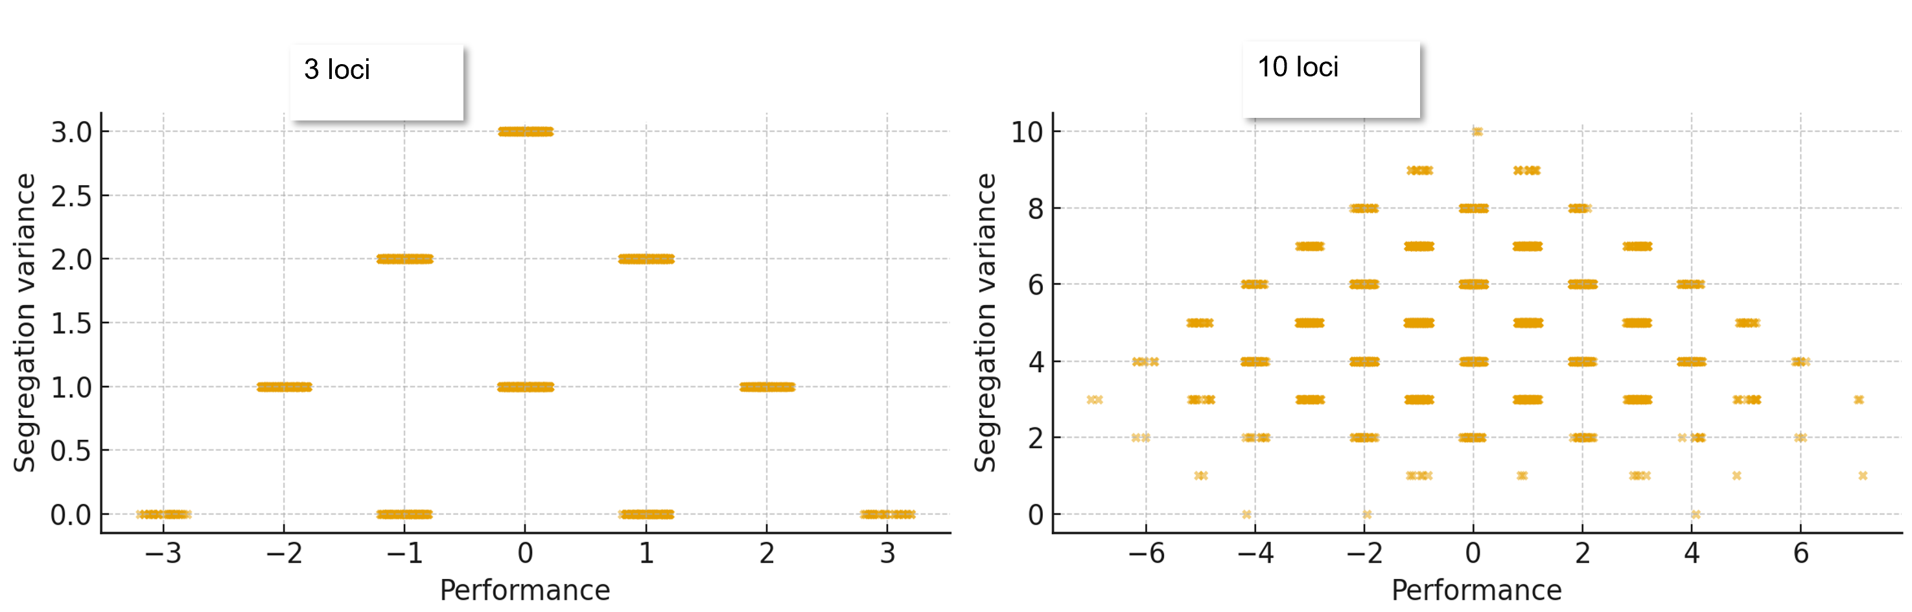
Ideal setting (HWE). S0-plants (non-inbred, F=0) are inbred to F=1, the genetic variance ‘inside’ their offspring is visualized. Analyse the connection between trait expression (phenotype; we assume h²=1) and the variance that segregates from these S0-individuals. For 10 loci, many random individuals were simulated from the basic pool.
S0 plant
S0-derived DH bulk or F∞ bulk. Here, some segregation is indicated.
7
Extreme
emertxE

Slide 8
64 genotypes, a=1. Zero dominance, LD=0. Ideal setting (HWE). Take the 64 individuals as S0-plants (non-inbred, F=0). Ponder the genetic variance inside their offspring: offspring which is produced via DH or via selfing to F=1 (of course no Selection Migration Mutation Drift).
The correlation between loci is zero, this is an idealized setting. The extreme-performing genotypes (#1; #64) segregate zero. Most average-forming types segregate, some even much.
Dots are slightly scattered on X-axis to ‘show’ frequency
[A1A2|B1B2|C1C2]
Type occurs 8 times (P=0.5³ ∙ 64)
Genetic variance inside S0-derived DH-families (or S0-derived F∞ bulks).
E.g: A1A2 causes performance of 0, inbred offspring is A1A1 or A2A2. These perform +1 and -1. Variance is 1.
[A2A2|B1B1|C1C1]
[A1A1|B2B2|C1C1]
[A1A1|B1B1|C2C2]
8

Slide 9
Ideal setting (HWE). S0-plants (non-inbred, F=0) are inbred, the genetic variance of inside their offspring is visualized. Connection between trait expression and variance that can segregate from these S0-individuals. 1000 random individuals are simulated from the ideal basic pool.
High variance is absent in case of extreme phenotype, since extreme performance is only possible with multi-homo-zygosity for either ‚always-good‘ or ‚always-bad‘ allele. This pattern is less strong in case of 10 loci. The frequency of types at -10 or +10 is extremely low (0.25¹⁰; < 1 per mio.). The rather extreme types that indeed do occur (e.g. -6 & +6 ) are (nearly) never fully homozygous (p² < 2pq). So: Not only maximum variance but as well zero variance is ► at extreme values on X-axis◄ very rare.
Extreme
emertxE
9

Slide 10
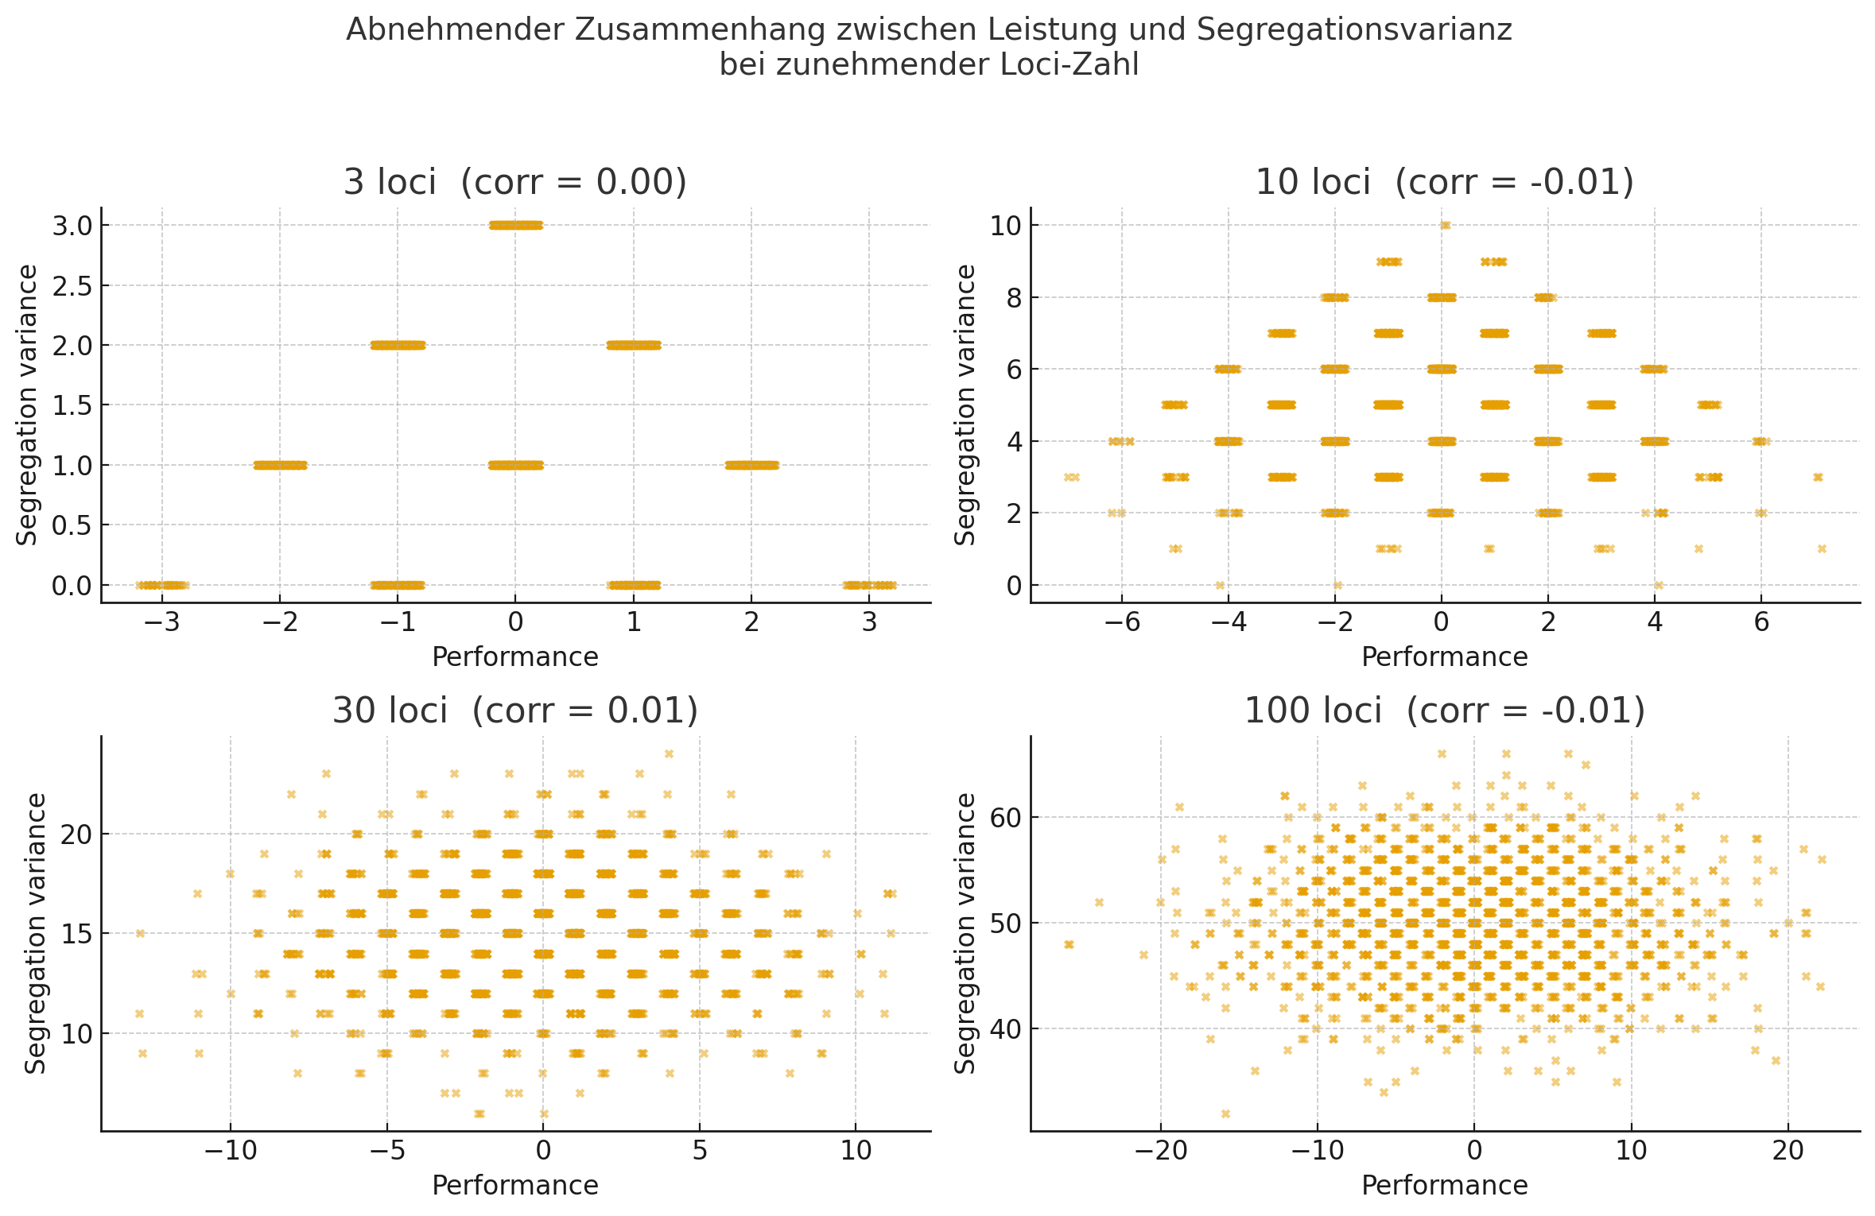
The systematic connection between genotypes‘ performance and variance that segre-gates from them when developing their ‚bulks of DHs‘ vanishes with locus number ↑.
Analysis with ChatGPT
σ²_{G} in our HWE (F=0) population (N loci): σ²_{G} = N ∙ (½ a²) = 50.
N=3: Extreme performing genotypes must be homozygous for all positive or negative alleles and thus don‘t se-gregate. N=many: Extreme geno-types are very rare! With the then-existing genotypes, no prediction is possible from (1) number of loci ho-mozygous for favourable allele (~per-formance) and (2) number of hetero-zygous loci (segregation). A genotype with e.g. performance 20 could as well have ● 80 loci heterozygous and 20 loci ‘homozygous good’ ►segre-gate much or ● 20 loci heterozygous and 50 loci homozygous ‘good’ and 30 homozygous ‘bad’ ►segregate little; and many options more.
HWE at p=q=0.5, a=1 and d=0, for all N loci.
3 loci
10 loci
30 loci
100 loci
10

Slide 11
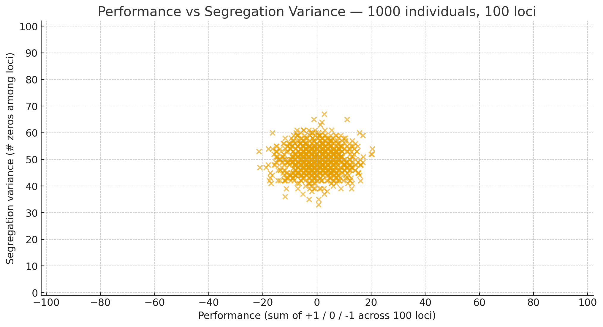
A genotype with heterozygosity at all 100 loci would lead to a panel of DH lines with a σ²_{G} = 100. A genotype with homozygosity at all 100 loci ‚good‘ would perform 100.
1000 individuals were simulated with 100 loci, LD=0, a=1 and d=0 per locus, p=q=0.5
reminder
These types do not exist here because of too low probability to come into existance
Segregation Variance within S0-derived F∞ bulks
Performance of HWE individuals (S0) ‘made’ by 100 loci.
Performance ‘made’ by 100 loci
11

Slide 12
A genotype with heterozygosity at all 100 loci would lead to a panel of DH lines with a σ²_{G} = 100. A genotype with homozygosity at all N=100 loci ‚good‘ would perform 100.
1000 individuals were simulated with 100 loci, LD=0, a=1 and d=0 per locus, p=q=0.5
Since default assumption in Quantitative Genetics is N=∞, variance on X- and Y-axis shrinks. With N=very high & LD=0 (zero linkage), geno-types are expected to differ little in performance and cause more or less the same (small) σ²_{G} when looking on the panel of DHs derived from them.
The Qu.G.-equations such as (in our case):
σ²_{G(within F∞-bulks)} = σ²_{A} = ½ a² ….
such equations are meant as mean for all the many possible S0-individuals and homozygous bulks deriva-ble from them. The mean variance within such homo-zygous bulks is this
σ²_{G} = σ²_{A} = 50. As ex-plained, the variation bet-ween these bulks for their ‚within-variance’ is neglec-ted and negligible. For mo-no- and oligogenetic traits, this neglection is too harsh.
Segregation Variance within S0-derived F∞ bulks
50
Performance of HWE indivs. (S0) vs. Seg. Variance within F∞ bulks derived from them
Performance ‘made’ by 100 loci
12

Slide 13
A genotype with heterozygosity at all 100 loci would lead to a panel of DH lines with a σ²_{G} = 100. A genotype with homozygosity at all N=100 loci ‚good‘ would perform 100.
1000 individuals were simulated with 100 loci, LD=0, a=1 and d=0 per locus, p=q=0.5
Since default assumption in Quantitative Genetics is N=∞, variance on X- and Y-axis shrinks. With N=very high & LD=0 (zero linkage), geno-types are expected to differ little in performance and cause more or less the same (small) σ²_{G} when looking on the panel of DHs derived from them.
The Qu.G.-equations such as (in our case):
σ²_{G(within F∞-bulks)} = σ²_{A} = ½ a² ….
such equations are meant as mean for all the many possible S0-individuals and homozygous bulks deriva-ble from them. The mean variance within such homo-zygous bulks is this
σ²_{G} = σ²_{A} = 50. As ex-plained, the variation bet-ween these bulks for their ‚within-variance’ is neglec-ted and negligible. For mo-no- and oligogenetic traits, this neglection is too harsh.
Segregation Variance between S0-derived F∞ bulks
50
Performance of HWE indivs. (S0) vs. Seg. Var. between F∞ bulks derived from them
Performance ‘made’ by 100 loci
13

Slide 14
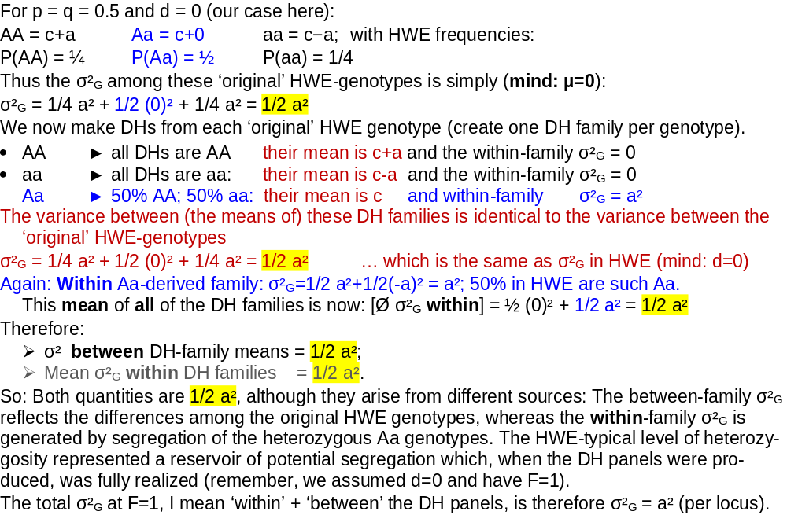
A side remark …
σ² between DH-family means = 1/2 a²
Mean σ²_{G} within DH families =
1/2 a²
(you saw it earlier here)
● Two same amount of
genetic variance
Page 22 will deal with this, too.
14

Slide 15
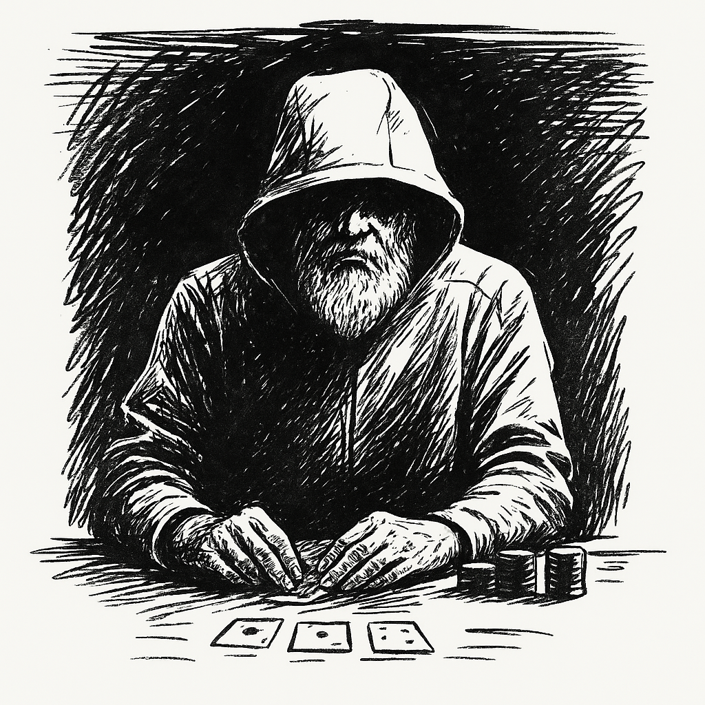
Bernoulli sends his regards
So.
We now continue with focus on the mean case and neglect
the differences between individuals and families for their
frequency of good-allele and frequency of homozygosity
(alike in state) and for the potential variance they contribute
via the segregation of the gametes made by them.
I repeat: We now deal with the average case, the typical case,
the usually to-be expected case.
We do this although .. Plant Breeding is partly a game, a gambler’s job, a bet, even against the odds, and although the winners are the outliers, not the average types.
On the following pages, we recall that although a covariance of zero is desirable, this is (un)fortunately no longer the case if there is a certain degree of inbreeding (F>0) in our population ...
15

Slide 16
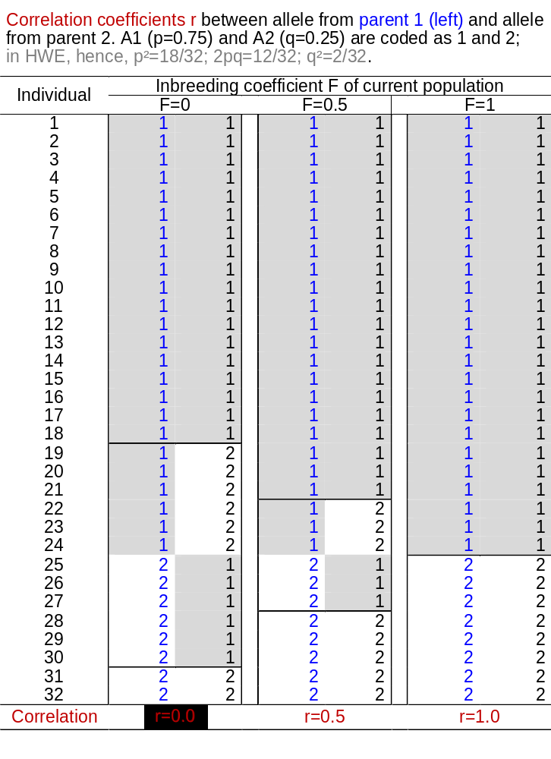
Populations‘ Genetic Variance depends on many parameters incl. populations‘ inbreeding coefficient F.
16
In case of F=0, we cannot predict an individual’s 2nd allele after knowing the 1st one (at the locus* we are currently considering; take the 1st allele as ‘from egg-cell received’ the 2nd as ‘pollen-grain received’ - if you like). With e.g. p=0.75, the probability that the 2nd is A1 – given A1 was the 1st - is 0.75. The probability that the 2nd is A1 – given A2 was the 1st - is 0.75, too. The prob. that the 2nd is A2 – given A1 was the 1st or given A2 was the 1st - is 0.25, which is just the frequency of A2 in the pool. You see the point.
But: With e.g. F=0.5, this is not random! Given the 1st is A1, then the probability to have A1 as second is larger: It is half-way between 0.75 and 1.00 (0.875) ... et cetera. And: With e.g. F=1, you know the 2nd for sure. If the 1st is A1, then the 2nd is A1, too; et cetera.
With F=0, this fact of r=0.0 is the reason for σ²_{A} = σ²_{α'} + σ²_{α‘’} and for covariance α' & α'' not being involved here. “The genetic additive variance caused by the ‘first-allele’ and caused by the ‘second-allele’ just add up to the total additive variance of the locus”.
Visit again UNPLAB-QuGen_Ch8[Decomp-GenV I] pages 20, 21.
24 is 75.0% of 32
18 is 75.0% of 24
21 is 87.5% of 24
24 is 100% of 24
;-)
*locus segregates!

Slide 17
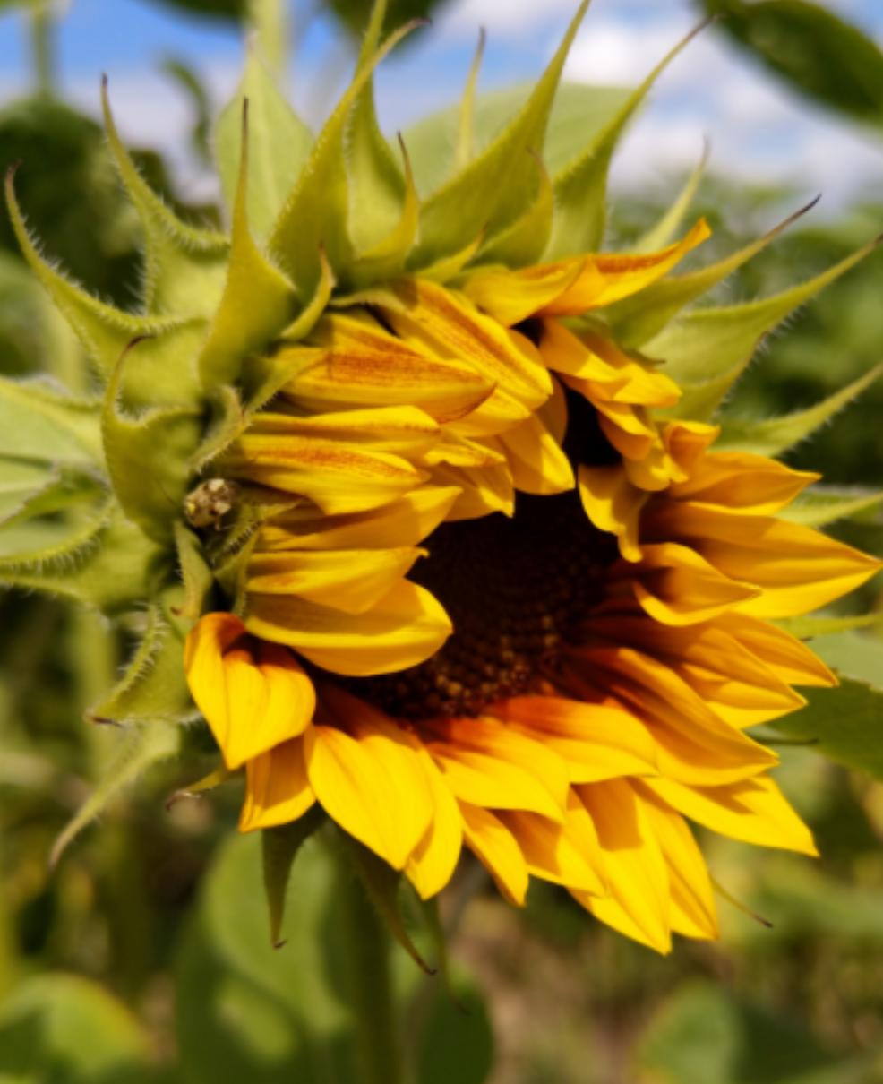
Populations‘ genetic variance depends on F of the population. ISBN 978-0-87893-481-2
As indicated here again, the mean impact of α₁ and α₁ and of δ₁₁, δ₁₂ and δ₂₂ on the Reference Population’s mean µ is zero.
And: More ‚un-correlation‘! With F=0 ... UNPLAB-QuGen_Ch8[Decomp-GenV I] page 32ff ... even the statistical additive effects and domi-nance deviations of a locus are uncorrelated .
This is all not true in case of F>0.
Here, we are not concerned with associations due to LD (association between alleles at different loci), nor with correlations between gene-tic effects at different loci resulting from Epistasis. Nor are we refer-ring to correlations between homozygosity/heterozygosity at different loci caused by variation in inbreeding among individuals. The latter is indeed expected if individuals of the population differ for their inbreeding (e.g. in case of a partial allogamous population). Then a homozygous status at one locus predicts that any other locus is more likely to be homozygous than the p²+q² expected under HWE would indicate. This would be a correlation between the homozygous/hete-rozygous status, not between alleles (DOI 10.2307/2530754).
© Wolfgang Link 2026
17

Slide 18
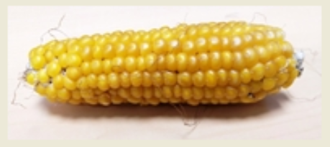
Populations‘ genetic variance depends on F of the population. ISBN 978-0-87893-481-2
As indicated here again, the mean impact of α₁ and α₁ and of δ₁₁, δ₁₂ and δ₂₂ on the Reference Population’s mean µ is zero.
And: More ‚un-correlation‘! With F=0 ... UNPLAB-QuGen_Ch8[Decomp-GenV I] page 32ff ... even the statistical additive effects and domi-nance deviations of a locus are uncorrelated .
This is all not true in case of F>0.
In case of F>0, “σ²_{G} = σ²_{A} + σ²_{D}” does not work any more (well: It does, if we have the special case of p=q=0.5; in this case, of course, all the nice “(p-q)”- bits of the Algebra cause zero ... and again, it does, of course: If d=0. Then the topic implodes and is ‘solved’ by such implosion ;-) .
In case of F>0, we usually find σ²_{G} ≠ σ²_{A} + σ²_{D}. If we still want to describe σ²_{G} in terms of σ²_{A} + σ²_{D} - then we have to patch it up and correct it. Let us assume 2 alleles per locus to allow us simplify matters.
We know: σ²_{A} = 2pq[a-(p-q)d]² σ²_{D} =[2pqd]²
To patch it up, we need:
D1 =2pq[a-(p-q)d]∙[(p-q)d] Covariance of the α_{j} with the homozygous δ_{jj}
D2* = 4pq[(p-q)d]² Variance of the single-locus inbreeding depression
σ²_{G} =(1+F) σ²_{A} + (1-F) σ²_{D} + 4 F D1 + F D2* + F (1-F) H* Here: with 2 alleles per locus, H* = σ²_{D}
18

Slide 19
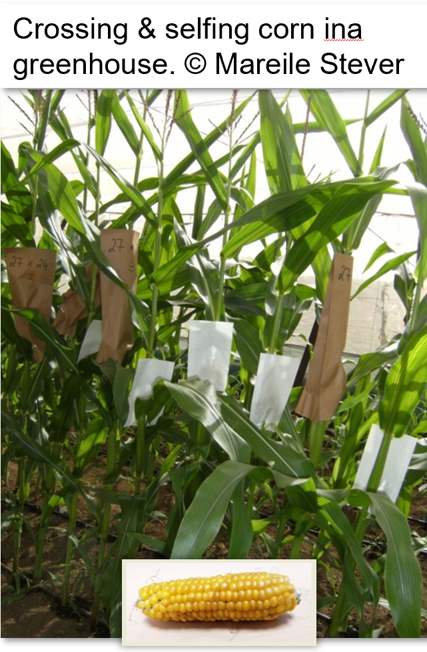
Just take another look.
As indicated here again, the mean impact of α₁ and α₁ and of δ₁₁, δ₁₂ and δ₂₂ on the Reference Population’s mean µ is zero.
And more such ‚un-correlation‘! With F=0 ... UNPLAB-QuGen_Ch8[Decomp-GenV I] page 29 ... even the statistical additive effects are uncorrelated toe the dominance deviations.
This is all not true in case of F>0.
In case of F>0, “σ²_{G} = σ²_{A} + σ²_{D}” does not work any more (well: It does, if we have the special case of p=q=0.5; in this case, of course, all the nice “(p-q)”- bits of the Algebra cause zero ... and again, it does, of course: If d=0. Then the topic implodes and is solved that way ;-) .
In case of F>0, we usually find σ²_{G} ≠ σ²_{A} + σ²_{D}. If we still want to describe σ²_{G} in terms of σ²_{A} + σ²_{D} - then we have to patch it up and correct it. Let us assume 2 alleles per locus to allow us simplify matters.
We know: σ²_{A} = 2pq[a-(p-q)d]² σ²_{D} =[2pqd]²
To patch it up, we need:
D1 =2pq[a-(p-q)d]∙[(p-q)d] Covariance of the α_{j} with the homozygous δ_{jj}
D2* = 4pq[(p-q)d]² Variance of the single-locus inbreeding depression
σ²_{G} =(1+F) σ²_{A} + (1-F) σ²_{D} + 4 F D1 + F D2* + F (1-F) H*
Here: with 2 alleles per locus, H* = σ²_{D}
19

Slide 20
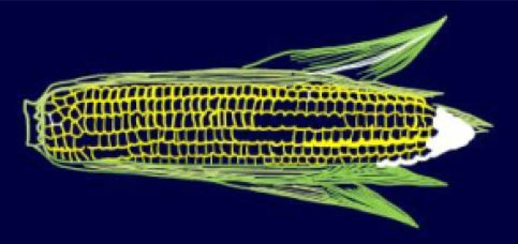
Populations‘ genetic variance depends on F of the population. ISBN 978-0-87893-481-2
© M. Tost
In case of F>0, σ²_{G} ≠ σ²_{A} + σ²_{D}. If we still want to describe the genetic variance interms of σ²_{A} + σ²_{D} - then we have to patch it up and correct it. Let us assume 2 alleles per locus to allow us simplify matters.
We know:
σ²_{A} = 2pq[a-(p-q)d]² Additive Variance; σ²_{D} =[2pqd]² Dominance Variance.
To patch it up, we need:
D1 =2pq[a-(p-q)d]∙[(p-q)d] Covariance of α₁ or α₂ with the homozygous δ₁₁ or δ₁₁ (respectively)
D2* = 4pq[(p-q)d]² Variance of the single-locus inbreeding depression
σ²_{G} =(1+F) σ²_{A} + (1+F)(1-F) σ²_{D} + 4 F D₁ + F D₂*
With F=1, this makes for instance: σ²_{G} =2 σ²_{A} + 4 F D₁ + F D₂* ; the frequently circulated statement ...
“With F=1, σ²_{G} =2 σ²_{A}” ... this is therefore only true if p=q and/or d=0. Otherwise it is more or less ... wrong.
20

Slide 21

Genetic variance with e.g. F=0.7
σ²_{G} =(1+F)σ²_{A}+(1-F)σ²_{D}+4 F D1+F D2*+F(1-F)H*
160
Using σ²_{A} to describe σ²_{G} if F>0, we get a ‘biased’ value for σ²_{A}. E.g., with p≤0.455, σ²_{A} > σ²_{G} which is apparent nonsense. We correct this mainly by D1, for further fine-tuning we employ D2* and in case of >2 alleles per locus, even H*.
The problem stems from using pa-rameters which are designed for F=0. May be we should have specifically tailored parameters for F>0. What do you think?
σ²_{G} =(1.7)σ²_{A} + 0.3σ²_{D} + 2.8 D1 + 0.7D2* + 0.21H*
140
120
Genetic
Variance
Additive Variance
100
80
60
40
Dominance
Variance
Components of Genetic (Co-)Variance
(100 loci); F=0.7)
D2*
20
H*
0
-20
-40
We have here: a=d=1 and 100 unlinked loci, all with same fre-quency of their dominant allele, so p(A1)=p(B1) … et cetera.
-60
D1
-80
-100
0.455
p(A1)
-120
0.0
0.1
0.2
0.3
0.4
0.5
0.6
0.7
0.8
0.9
1.0
21

Slide 22
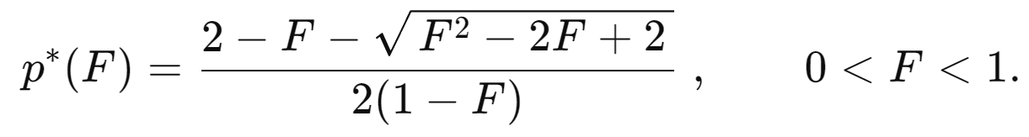
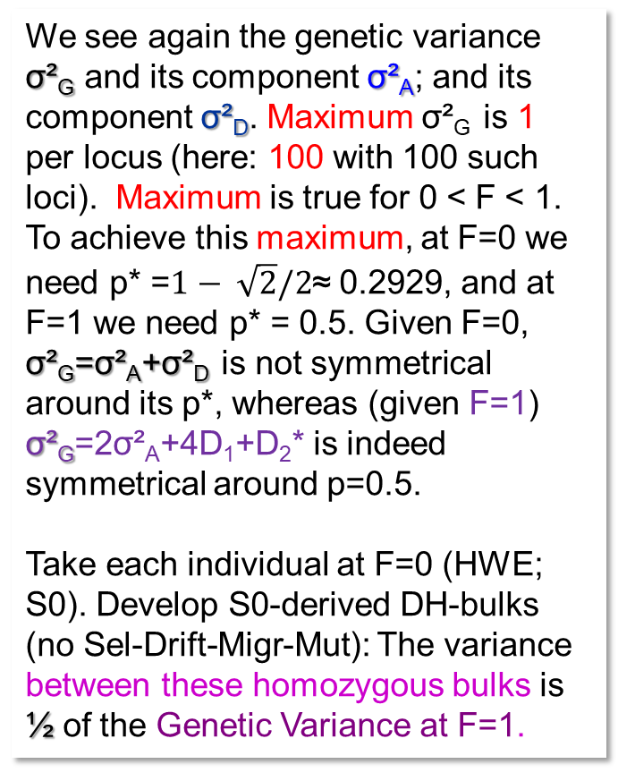
Compare Genetic Variance at F=0.0 and at F=1.0. 100 loci, LD=0, a=d= 1 throughout.
We see again the genetic variance σ²_{G} and its component σ²_{A}; and its component σ²_{D}. Maximum σ²_{G} is 1 per locus (here: 100 with 100 such loci). Maximum is true for 0 < F < 1. To achieve this maximum, at F=0 we need p* =$1− \sqrt{2}/2$≈ 0.2929, and at F=1 we need p* = 0.5. Given F=0, σ²_{G}=σ²_{A}+σ²_{D} is not symmetrical around its p*, whereas (given F=1) σ²_{G}=2σ²_{A}+4D₁+D₂* is indeed symmetrical around p=0.5.
Take each individual at F=0 (HWE; S0). Develop S0-derived DH-bulks (no Sel-Drift-Migr-Mut): The variance between these homozygous bulks is ½ of the Genetic Variance at F=1.
100
F=0
Genetic Var.
σ²_{G}=σ²_{A}+σ²_{D}
F=1
Genetic Variance
σ²_{G}=2σ²_{A}+4D₁+D₂*
90
80
70
F=0 Additive
Variance
60
Variance (100 loci)
50
F=1; Genetic Var. between S0-de-rived homozygous bulks
40
30
20
F=0 Dom. Variance
10
0.50
0
0.0
0.2
0.2929
0.4
0.6
0.8
1.0
p(A1)
22

Slide 23
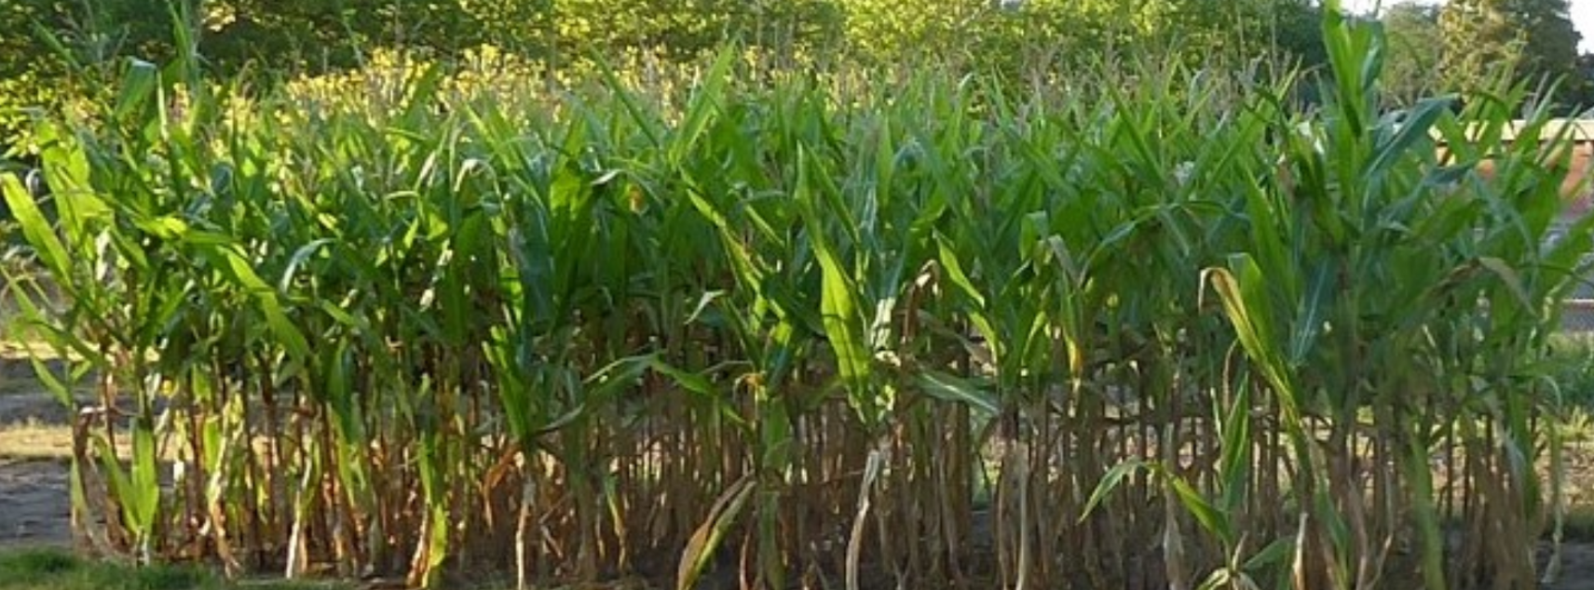
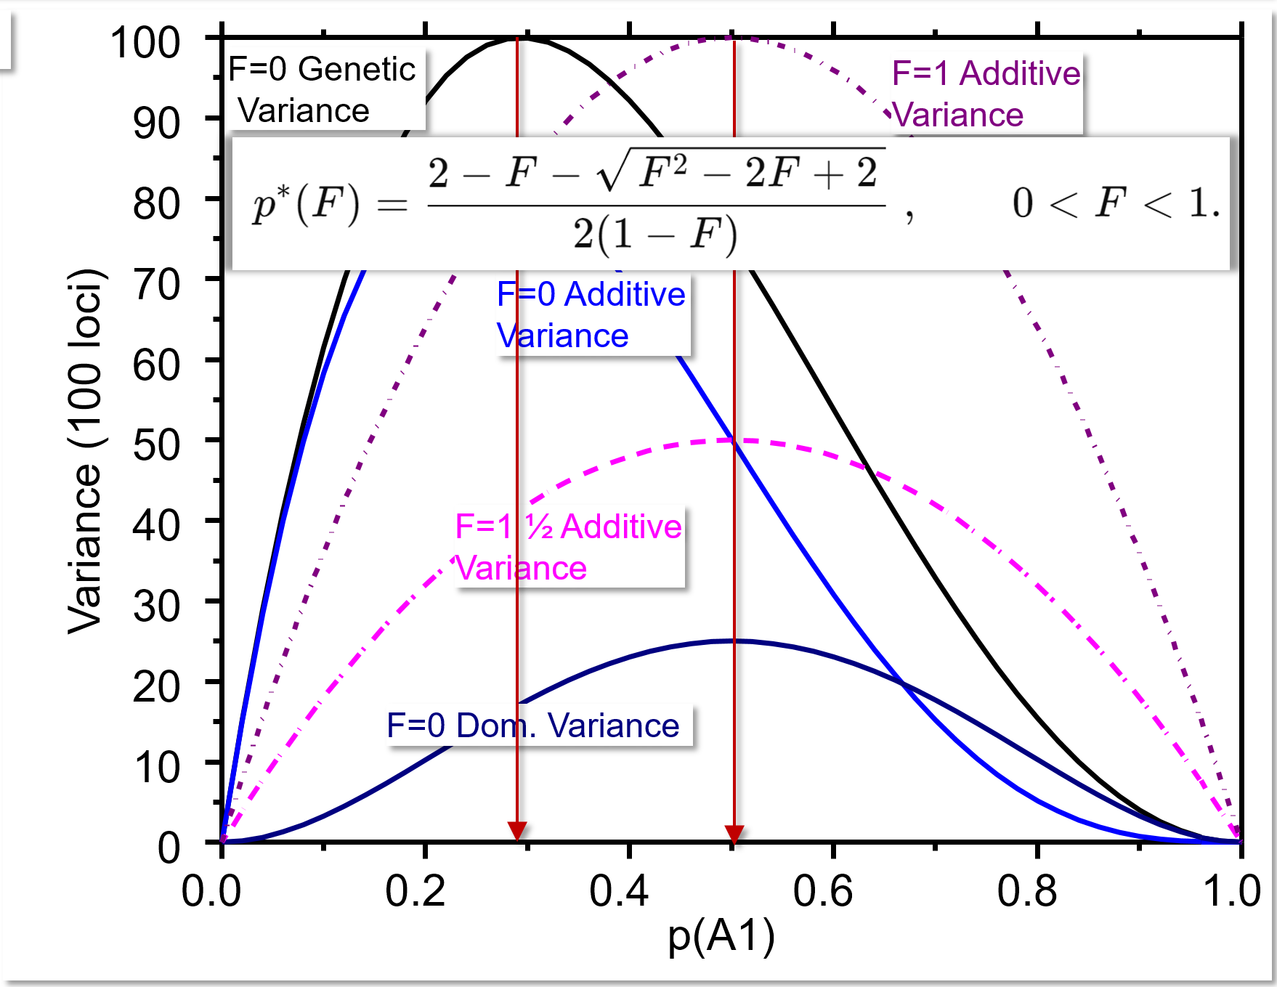
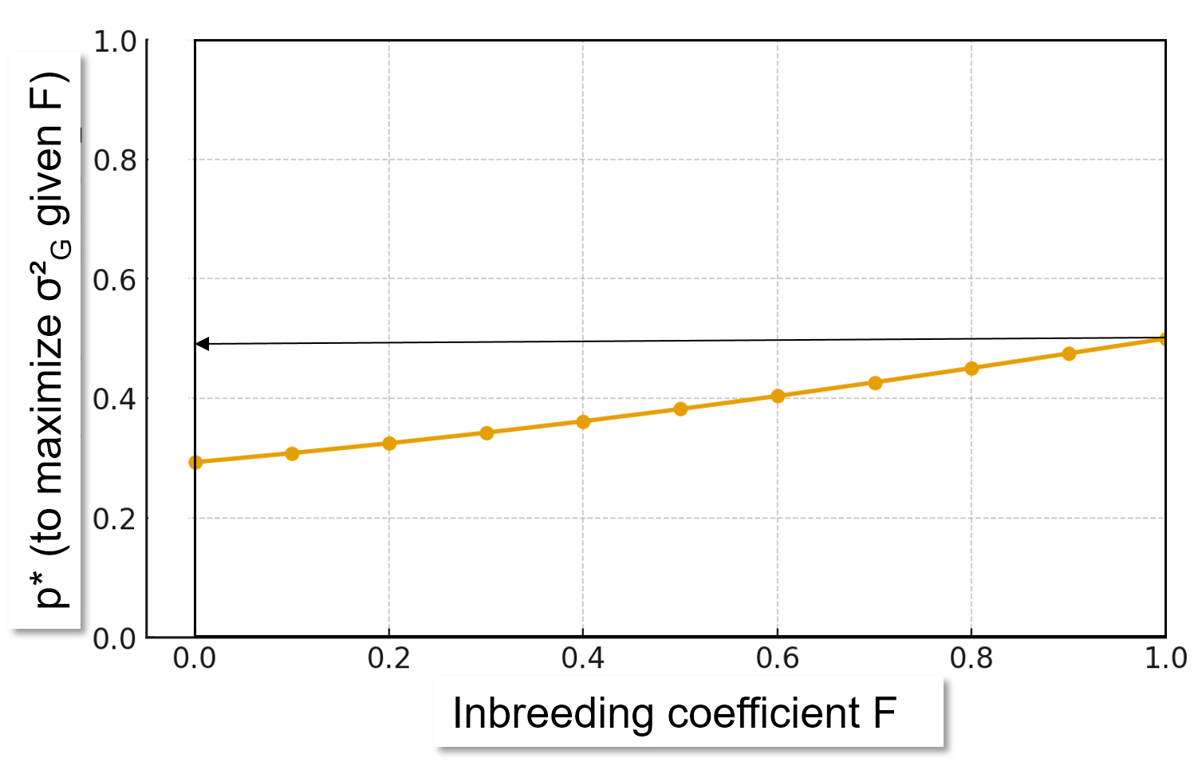
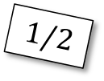
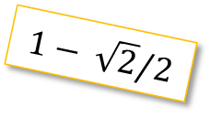
p*(A1) for max. σ²_{G}; at F=0.0 or at F=1.0
© SY
100 loci, LD=0, a=d=1. At F=0, σ²_{G} is max. (i.e. 100) with p*≈0.2929. At F=1, σ²_{G}=100 with p* = 0.5. This p* is set so that, regardless of F, one group, namely [AA and Aa], and the other group, namely [aa], occur with equal frequency. Then-there, as they are 1:1, the maximum genetic vari-ance is achieved (per locus; per 100-loci-trait).
Yes, of course, not all details are equal-ly fascinating to everyone; well.
$$1/2$$
$$1− \sqrt{2}/2$$
23

Slide 24

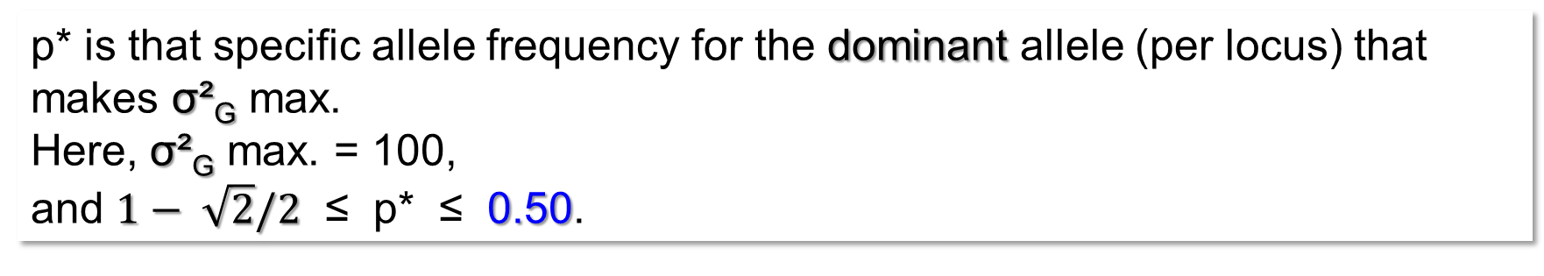
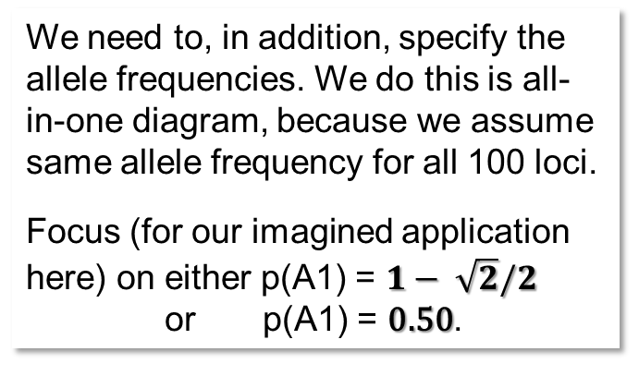

p* is that specific allele frequency for the dominant allele (per locus) that makes σ²_{G} max.
Here, σ²_{G} max. = 100,
and $1− \sqrt{2}/2$ ≤ p* ≤ 0.50.
F=0.0
F=0.1
F=0.2
100
a=d=1
F=0.3
F=0.4
F=0.5
‚Application‘. 100 loci throughout. LD=0; a=1 throughout.
1 Grain yield, d=1 F=0
2 Grain yield, d=1 F=1
3 Baking quality, d=0 F=0
4 Baking quality, d=0 F=1
Specify the size of the genetic variance in these four cases.
80
F=0.6
F=0.7
F=0.8
F=0.9
60
F=1.0
Genetic variance (100 loci)
The maximum variance here is always 100; the resolution of the visualization is - alas - a bit too coarse to show this well.
40
We need to, in addition, specify the allele frequencies. We do this is all-in-one diagram, because we assume same allele frequency for all 100 loci.
Focus (for our imagined application here) on either p(A1) = $1− \sqrt{2}/2$
or p(A1) = 0.50.
20
Instead of fixing gene action at a=d=1, we now allow two contrasting types of gene action, as you see.
So, again, either
Dominance, a=d=1
Intermediate, a=1 but d=0.
And ... we consider either F=0 or F=1
$$1− \sqrt{2}/2$$
$$0.50$$
0
0.0
0.1
0.2
0.3
0.4
0.5
0.6
0.7
0.8
0.9
1.0
p(A1)
24

Slide 25
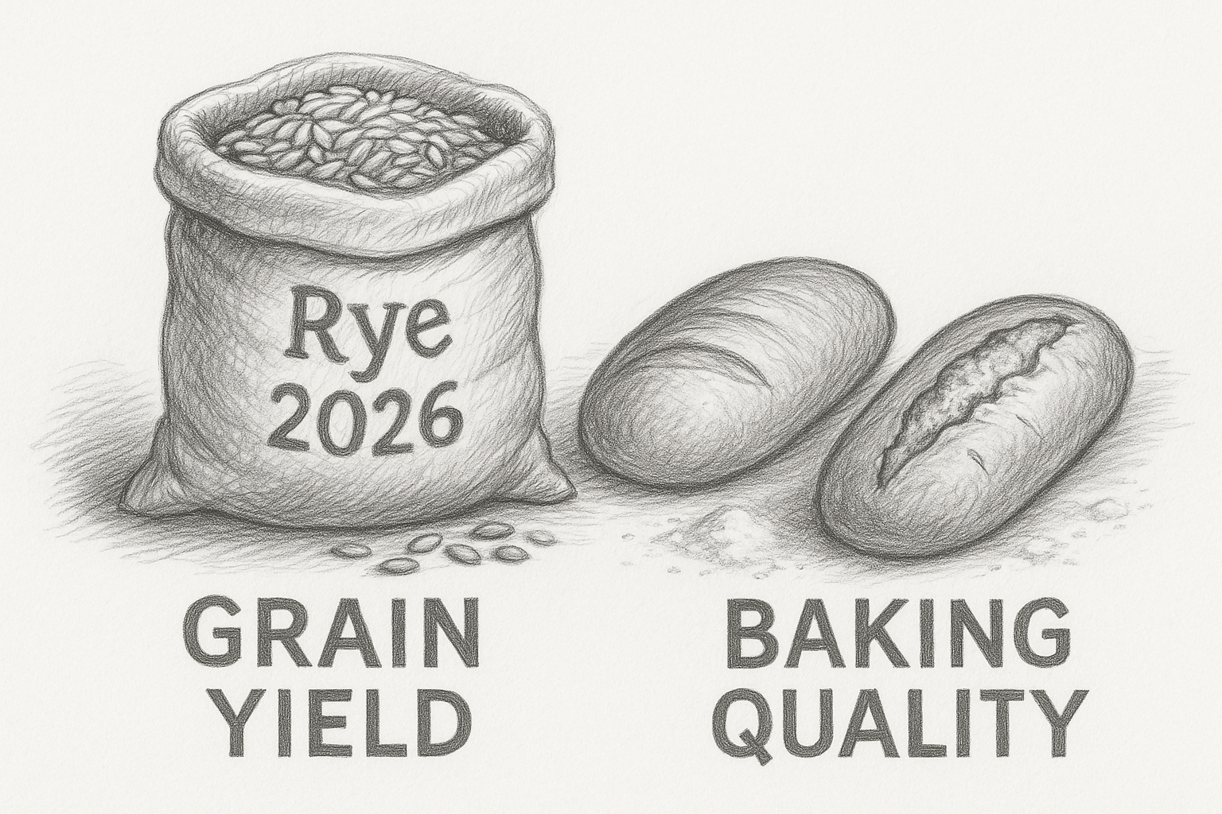
Remember. Fitness-related traits such as grain yield show high heterosis hence high inbreeding depression. Traits with a small impact on natural fitness such grain quality for baking (grain protein content, protein composition) show little heterosis hence small inbreeding depression.
As long as the major part of heterosis is explained* by the sum of single-locus dominance (d>0, typically d≤a), we will use the following conceptual model: Dominance-recessive gene action of the alleles at loci ‘for’ Grain Yield and intermediate gene action ‘for’ Baking Quality. To make it easy: a=d=1 for Grain Yield, a=1 but d=0 for Baking Quality.
*explained? The genetic explanation of heterosis is specific to each trait and population. Whatever the ‚true‘ biological reason or explanation may be, much of it can be well modelled with the assumption of dominance-of-vigour-’making’ allele. Minor shares of the variation of heterosis are explained by assuming overdominance and/or epistasis. There is of course some ‘unexplained space’ needing for further research: Epigenetics for ins-tance. We must always be clear that our Quantitative-Genetic models are Models. They ignore biological phenomena such as the Michelis Menten kinetics and so on. And: “Loci ‘for’ grain yield“? Rather „Loci, the segregation of which have impact on the genetic variation of grain yield“. Cave res parvas!
“a=1; d=0”
“a=d=1”
25

Slide 26
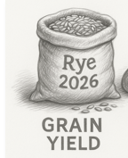
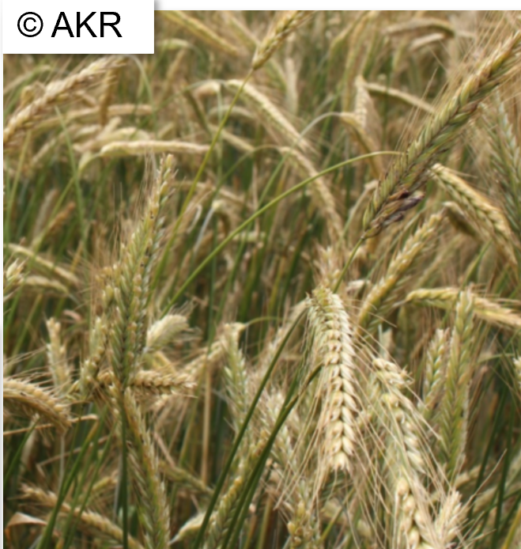

Impact of gene action, inbreeding coefficient and allele frequency on genetic variance
We need a, d, F, and p(A1). Here, the frequency of the ‚A1‘-allele at our 100 loci is only one figure, because we anyway assume same allele frequency for all these 100 loci. Let us take either p(A1) = $1− \sqrt{2}/2$ or p(A1) = 0.50.
Trait | a | d | F | p(A1) | σ²_{G} | Amount realized
 |  |  |  |  |  | σ²_{A} | σ²_{D}
Grain yield | 1 | 1 | 0 | 0.29289. | 100.00 | 82.84 | 17.16
 |  |  |  | 0.50000 | 75.00 | 50.00 | 25.00
 |  |  | 1 | 0.29289 | 82.84 | 165.68 | 0.00
 |  |  |  | 0.50000 | 100.00 | 100.00 | 0.00
Baking quality |  | 0 | 0 | 0.29289 | 41.42 | 41.42 | 0.00
 |  |  |  | 0.50000 | 50.00 | 50.00 | 0.00
 |  |  | 1 | 0.29289 | 82.84 | 82.84 | 0.00
 |  |  |  | 0.50000 | 100.00 | 100.00 | 0.00
You see the outcome. With dominance (d=1), the allele frequency p(A1) to maximize σ²_{G} depends on F. Without dominance and F=0, genetic variance is max. 50 instead of 100 (this is because the ‚second half‘ of the variance is in the heterozygosity of the non-inbred plants and still has to segregate upon inbreeding). the genetic variance is same whether d=1 or d=0, yet, with dominance, σ²_{A} is not ‚fit‘ to describe the situation and needs to be corrected by adding 4D₁+D₂*; at p(A1)=0.2929, D₁ is negative (Again: This calamity is absent with p=q=0.5).
At F=1,
26

Slide 27
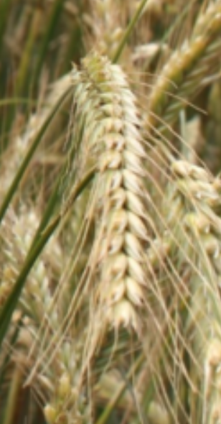
Effect of low to average frequency of dominant allele and of F
on: ►Population mean µ, ►genetic variance, ►Selection Differential S
… if selecting 1/3 best genotypes
27
Trait | a | d | F | p(A1) | σ²_{G} | Amount realized |  | Algebra employed to quantify σ²_{G}
 |  |  |  |  |  | σ²_{A} | σ²_{D} | Definitions rel. to HWE; F=0 | Based on Metric Effects a, d
Grain yield | 1 | 1 | 0 | 0.2929. | 100.00 | 82.84 | 17.16 | σ²_{G}=σ²_{A}+σ²_{D} | 2pq[a-(p-q)d]² + (2pqd)²
 |  |  |  | 0.5000 | 75.00 | 50.00 | 25.00 |  | ½ a² + (¼ d)²
 |  |  | 1 | 0.2929 | 82.84 | 165.68 | 0.00 | σ²_{G}=2σ²_{A}+4D_{1 ......................}+D₂* | 4pq a²
 |  |  |  | 0.5000 | 100.00 | 100.00 | 0.00 |  | a²
Baking quality |  | 0 | 0 | 0.2929 | 41.42 | 41.42 | 0.00 | σ²_{G}=σ²_{A} | 2pq a²
 |  |  |  | 0.5000 | 50.00 | 50.00 | 0.00 |  | ½ a²
 |  |  | 1 | 0.2929 | 82.84 | 82.84 | 0.00 | σ²_{G}=2σ²_{A} | 4pq a²
 |  |  |  | 0.5000 | 100.00 | 100.00 | 0.00 |  | a²
µ and S in case of selecting 1/3 better ones (i=1.0908)
µ before sel. | ‚S‘ | µ after sel. (if h²=1)
0.00 | 10.91 | 10.91
50.00 | 9.45 | 59.45
-41.42 | 9.93 | -31.49
0.00 | 10.91 | 10.91
-41.42 | 7.02 | -34.40
0.00 | 7.71 | 7.71
-41.42 | 9.93 | -31.49
0.00 | 10.91 | 10.91
The balancing effect of p(A1)=0.2929 in HWE, causing 50% [AA or Aa] types and 50% [aa] types is seen again here since then and with a=d=1, µ=0. The same is true with p(A1)=0.500 in case of F=1 (no matter whether d=1 or d=0).

Slide 28
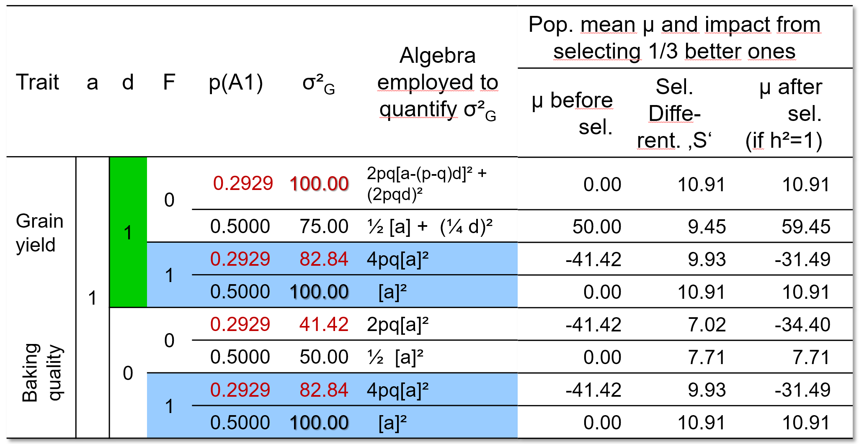
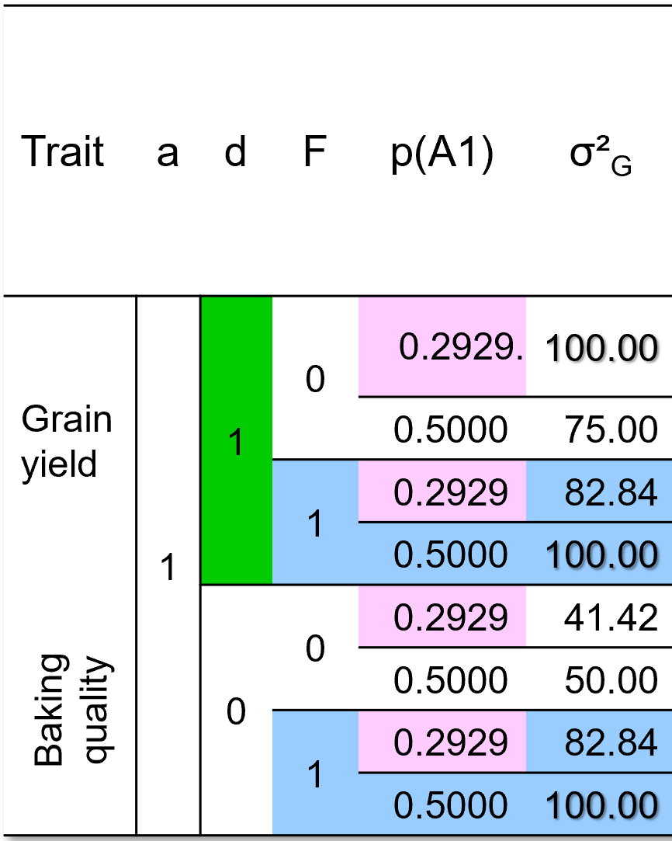
Imagined application on Grain Yield and on Baking Quality
We learn from these eight ca here. The by far highest µ after selection is found for F=0 with d=1 and p=0.5 (case 2). The reason is the high mean performance before selection (µ=50). Genetic variance is not maximum, it is only 75. To start with a very good material is important and could not be compensated by any of the seven other cases.
Compare cases 1, 4, 6, 8 with µ(before)=0.
8 cases
1
2
3
4
5
6
7
8
Case 6 is unfortunate because of the small σ²_{G}. Here, we select between HWE individuals. Only half of the variance is displayed (the other half is ‚stored‘ as heterozygosity of the individuals ); and no dominance adds variance. Case 6 is yet ‚better‘ than the cases 3, 5 and 7: Although in 6, variance is small, its µ is high because p=0.5 (instead of p=0.2929). The higher µ overcompensates here its small ‚S‘. Case 5 is very unfavourable. Like 6, we are in HWE, only ½ of σ²_{G} is available, and we have low µ due to low p (p=0.2929). The three cases 1, 4 and 8: Although they lead to the same µ after selection (10.91), they differ. Case 1 selects the 1/3 best ones among non-inbreds, whereas in cases 4 and 8 the 1/3 best ones are homozygous. In case 1, can we - ? - use these best ones directly (Clone Bree-ding) or only via their Breeding Value (Population Breeding)? Or are we possibly even breeding line cultivars. Then case 1 shrinks to case 5, since then it is the ‚value‘ of the selected S0 individuals for breeding homozyous lines that is realized rather than their HWE-defined Breeding Value or their ‚own‘ genotypic value. Hm …
28

Slide 29
Imagined application on Grain Yield and on Baking Quality
29
Did you frown and wonder why some of the mean values are negative (-41.42 in cases 3,5,7)? To overcome and remedy this, just assume that in our population we have e.g further 100 loci, yet, these are monomorphic with the ‘good’ allele. So: We add a constant of 100 to the trait(s). Hence, now µ before se-lection is 58.58 or 100.00 or 150.00 – without change for what we learn and understand.
1
2
3
4
5
6
7
8
In case 1, we may employ as Selection Differential S=10.91, implying that the selected genotypes are direct candi-date cultivars, hence, implying Clone Breeding. Which crop should this be? It must not be autopolyploid (since then our simple Quantitative Genetics algebra doesn‘t fit). It must be outcrossing to support our high heterosis (d/a=1 at all 100 loci). Maybe we imagine Cassava (aka Manioc, Manihot esculenta), starch crop although not really for bread. What should the reference population be? Would we hypothesize a kind of all-by-all crosses to mimic a reference HWE population in Cassava? If the crop is rye (diploid, outcrossing, for bread), can we then employ S=10.91? The best individuals of the population are not directly candidate cultivars. What if we mix these 1/3 superior individuals to create a population cultivar? In that case we would only exploit the additive variance σ²_{A;} part of d effects is grasped by σ²_{D} and did influence our selection but is not inherited via σ²_{A}. It is not S=100^{0.5}∙ 1.0908 =10.91 but it is S=82.84^{0.5}∙ 1.0908 =9.928; slightly smaller. In case 2, with p=q=0.5, this shrinkage difference would be larger ... why ;-) ?

Slide 30
Exploit σ²_{G} in this population in 2 steps.
Select a superior S0 individual
σ²_{G} in the HWE Population
30

Slide 31
Exploit σ²_{G} in this population in 2 steps.
Select a superior S0 individual
Derive DH lines from it and select
a superior DH-line
Exploit first σ²_{G} as is available in HWE, then exploit σ²_{G} within their DH bulks.
What is the correlation between genetic values of S0-individuals and means-of-DH bulks? ‚Complicated‘. With a=d, it is …
► r = (σ²_{A} +D1)/ [(σ²_{A}+σ²_{D})∙(σ²_{A}+2D₁+D₂*/2)]^{0.5}
E.g., with a=d=1, p=0.4: r= 0.866025
With a=d, it is
31

Slide 32
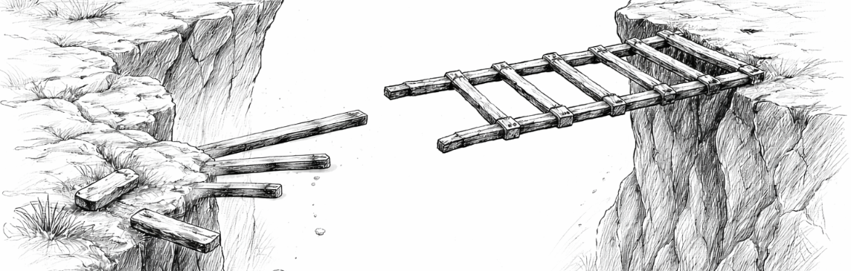
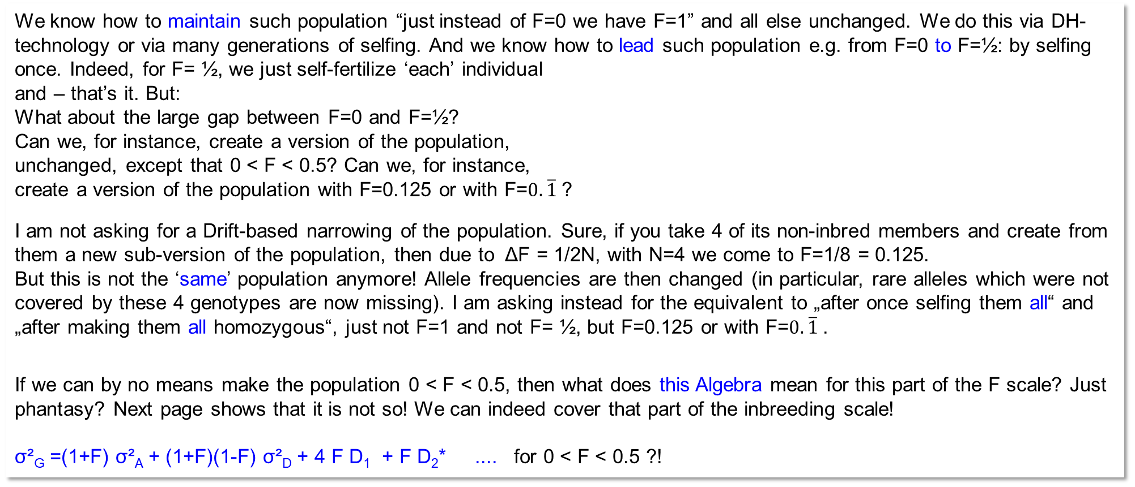
With σ²_{G} =(1+F) σ²_{A} + (1+F)(1-F) σ²_{D} + 4 F D₁ + F D₂*, we have Algebra to quantify the genetic variance for any level of inbreeding (no other changes, hence, no Selection, Mutation, Migration, Drift). 0 ... < .. F .. < .. 1.
0 .. < .. F .. < .. 1
We know how to maintain such population “just instead of F=0 we have F=1” and all else unchanged. We do this via DH-technology or via many generations of selfing. And we know how to lead such population e.g. from F=0 to F=½: by selfing once. Indeed, for F= ½, we just self-fertilize ‘each’ individual
and – that’s it. But:
What about the large gap between F=0 and F=½?
Can we, for instance, create a version of the population,
unchanged, except that 0 < F < 0.5? Can we, for instance,
create a version of the population with F=0.125 or with F=$0.\overline{1}$?
I am not asking for a Drift-based narrowing of the population. Sure, if you take 4 of its non-inbred members and create from them a new sub-version of the population, then due to ΔF = 1/2N, with N=4 we come to F=1/8 = 0.125.
But this is not the ‘same’ population anymore! Allele frequencies are then changed (in particular, rare alleles which were not covered by these 4 genotypes are now missing). I am asking instead for the equivalent to „after once selfing them all“ and „after making them all homozygous“, just not F=1 and not F= ½, but F=0.125 or with F=$0.\overline{1}$.
If we can by no means make the population 0 < F < 0.5, then what does this Algebra mean for this part of the F scale? Just phantasy? Next page shows that it is not so! We can indeed cover that part of the inbreeding scale!
σ²_{G} =(1+F) σ²_{A} + (1+F)(1-F) σ²_{D} + 4 F D₁ + F D₂* .... for 0 < F < 0.5 ?!
32

Slide 33
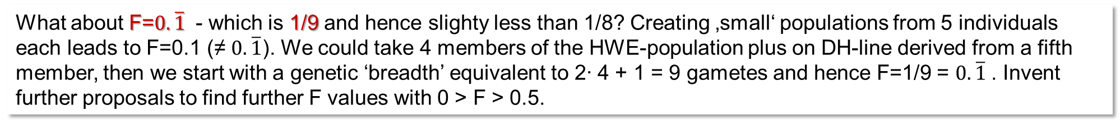
With σ²_{G} =(1+F) σ²_{A} + (1+F)(1-F) σ²_{D} + 4 F D₁ + F D₂*, we have Algebra to quantify the genetic variance for any level of inbreeding (no other changes, hence, no Selection, Mutation, Migration, Drift). 0<F<1.
F=0
F=0
Once selfing each
Repeatedly random mating each sub-population
F= ½
F= 1/(2N) = 0.125
Why here just once selfing for F=0.5 for every-body, in contrast to repeated random matings to get F=0.125 for everybody (see second diagram)?
The sum of N=∞ small populations which are (Drift) led to F=0.125, together, jointly, they still represent the initial di-versity of the population. Just now everybody is at F=1/8
What about F=$0.\overline{1}$ - which is 1/9 and hence slighty less than 1/8? Creating ‚small‘ populations from 5 individuals each leads to F=0.1 (≠ $0.\overline{1}$). We could take 4 members of the HWE-population plus on DH-line derived from a fifth member, then we start with a genetic ‘breadth’ equivalent to 2∙ 4 + 1 = 9 gametes and hence F=1/9 = $0.\overline{1}$. Invent further proposals to find further F values with 0 > F > 0.5.
33

Slide 34
Let us see whether we can derive Breeding Values ‘for’ Line Breeding (instead of for Population Breeding and Hybrid Breeding). What is the Breeding Value of a genotype if the task is not to transfer its ‘Value’ via crossing with the Reference Population to off-spring, but transfer its ‘Value’ via crossing with the Reference Population to the homozygous derivate of such offspring ... ?
homozygous derivate of
So far, we compared the offspring of candidates (F=0) from crossing these candidates with the Reference Population; F=0).
Instead, now, the Reference Population is at F=1 and we compare the F=1-derivate of the offspring (from crossing ...) with that Reference Population. Each genotype (candidate) is represented by a panel of DH-lines developed from its offspring … to assess its Line-Breeding focussed BV (named now BV∞).
By the way, the gametic array of the Reference Population is the same, whether it is the Original Reference Population at F=0 or it is its F=1-derivate ;-) ... this is because we assume LD=0 (and anyway no SelMigrMutDrift).
... Ah — now we’re in the club ;-)
‘ .... for this purpose’ wants to say: ‘for Line Breeding’
34

Slide 35
Candidates (S0) are crossed with the Reference Population to create S0 (next generation) ..
... the default step to assess their Breeding Value
♂ Gametic array of Reference Population

Our candidates
S0
S0
S0
S0
S0
S0
S0
S0
S0
S0
If our candidates are (a representative) sam-ple of the non-inbred Reference Population, then the Next generation is just the same non-inbred Reference Population.
But!
Specific here: We want to assess the candi-dates’ Line-Breeding focussed BV (BV∞).
S0
S0
S0
S0
35

Slide 36
.. then we produce RILs (F∞) from each S0. And then ... we compare these RIL panels with the ‘F=1-inbred’ Reference Population.
♂ Gametic array of Reference Population

Our candidates
S0
S0
S0
S0
S0
S0
S0
S0
F∞
S0
F∞
S0
F∞
S0
F∞
S0
F∞
S0
We ask for the Breeding Value of our candi-dates for Line Breeding; what is their ‚Value‘ if we use them to improve our Reference Population for the purpose of Line Breeding.
S0
F∞
F∞
36

Slide 37
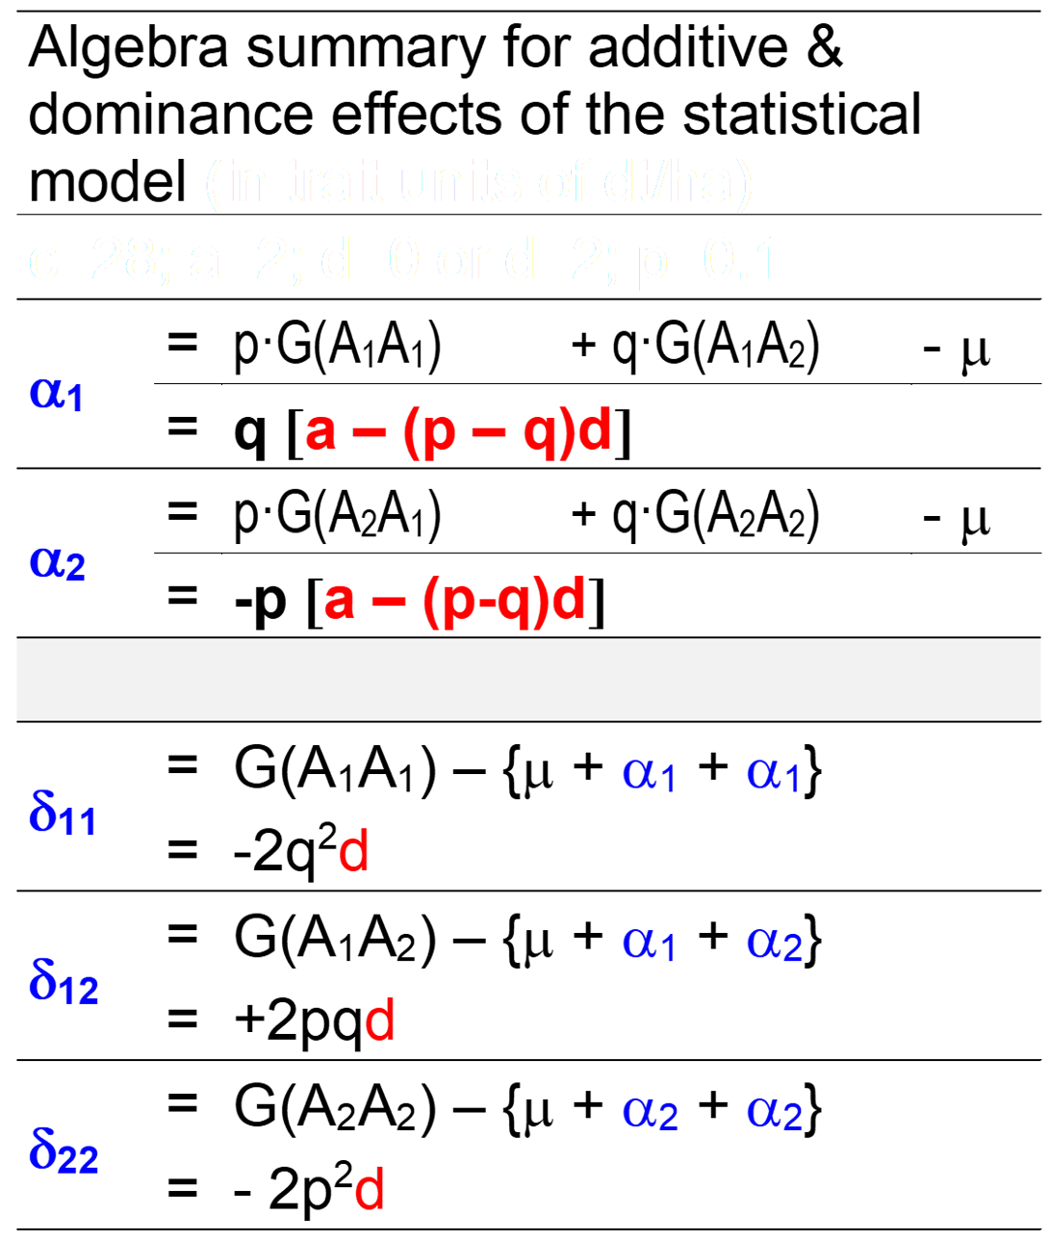
“BV∞” aka “A∞” as Breeding value of candidates in case the ‘to be improved’
Reference Population is at F=1 (not at “HWE i.e. F=0”).
As said before: To calculate the candidates’ BV∞, we compare locus-wise the offspring from mating the one and the other allele (note their frequencies) with the gametic array of the Reference Population, but now ... all these offspring are
brought to „F=1“ before being compared (NoSelMutMigrDrift).
Again: The Reference Population is at F=1.
Mean µ of Reference Population µ∞ = c + (p-q)a +2pqd.
Write ‘α∞₁’ as Additive Effect of allele A₁. Results are:
α∞₁ = qa ; α∞₂ = -pa BV∞: A1A1 ► 2α∞₁ et cetera
Write ‘δ∞₁₁’ as dominance deviation of genotype A₁A₁. Then:
δ∞₁₁ = δ∞₂₂ = 0 δ∞₁₂ = d
This was the case of F=0
|The heterozygous genotype A₁A₂ incorporates the effect d in its genotypic value yet cannot transfer this to its „F=1-offspring“|
37

Slide 38
α∞₁ = qa ; α∞₂ = -pa |on average, this is zero|
δ∞₁₁ = δ∞₂₂ = 0; δ∞₁₂ = d |on average, this is 2pqd|
BV∞: A1A1 ► 2α∞₁ | A1A2 ► α∞₁ +α∞₂ | A2A2 ► 2α∞₂
σ²∞(A) = 2pqa² = σ²_{A} + 2D₁ + ½ D₂* = half the genetic variance at F=1
This is the variance of the BV∞, if BV∞ are defined via a homozygous Reference;
so this should be suitable and apt for Line Breeding.
σ²∞(D) = 2pqd² - (2pqd)²
ω∞(A;D) = genetic covariance between these Breeding Values (BV∞) and the corresponding Dominance Deviations*. This covariance is not zero, quel domage.
It is ω∞(A;D) = 2pqad(q-p). watch out, it is …“(q-p)“.
The genetic variance at F=0 can be recomposed from these parameters:
 σ²_{G(F=0)} = σ²_{A} +σ²_{D} ….. ….. ….. so far so good and known
σ²_{G(F=0)} = σ²∞(A) + σ²∞(D) + 2 ∙ω∞(A;D) ….. So far so ‘new‘ ;-)
 2pq(a-(p-q)d)² + (2pqd)² = 2pqa² + 2pqd² - (2pqd)² + 2∙[(2pqad(q-p)]
*The Dominance Deviations in the HWE members with reference to their F=1 defined Breeding Values.
38

Slide 39
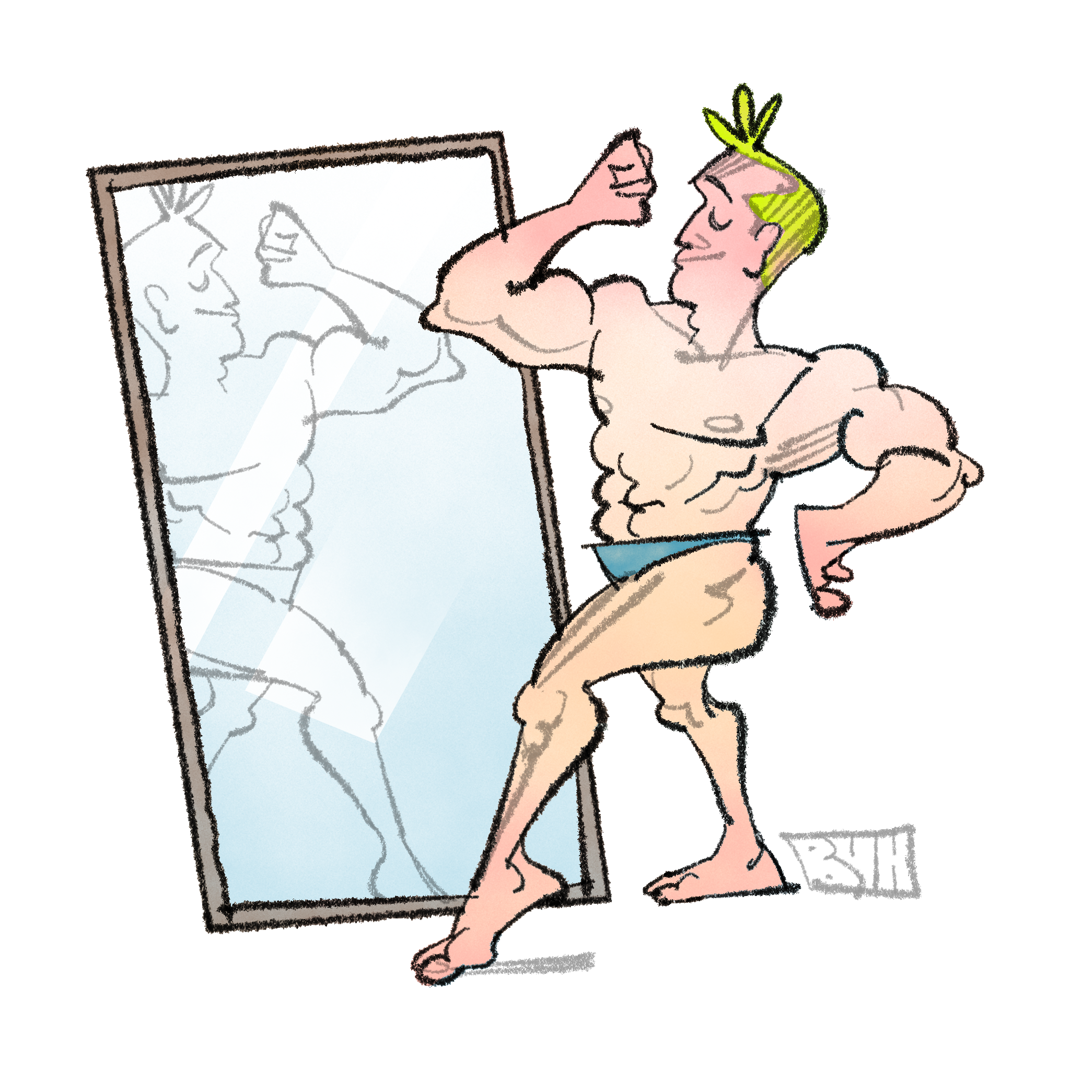
Join in my interest in … „What is it, that is realized in the genotypic values of the members of the HWE population but can not be transferred (via BV∞) into homozygous offspring of these HWE members“ ?
What is the difference between … the genotypic values G and the BV∞ values, and, honestly the main question here, what is the difference between
► … σ²(G) at F=0 and
► … σ²∞(A) which is relevant for F=1 (for Line Breeding) ?
Well, on last page we saw (F=0):
2pq(a-(p-q)d)² + (2pqd)² = 2pqa² + 2pqd² - (2pqd)² + 4pqad(q-p)
Therefore, the difference we requested, σ²(G) at F=0 versus σ²∞(A) is
2pq(a-(p-q)d)² + (2pqd)² - 2pqa² = 2pqd² - (2pqd)² + 4pqad(q-p)
That much: 2pqd² - (2pqd)² + 4pqad(q-p) which is identical to
that much: σ²∞(D) +2 ω∞(A;D) ...
is available if you directly select between the genotypic values of the HWE members and not any more available if you select between the DH-bulks (derived from the crosses between the candidates and the Reference Pop.)
A boaster, braggart, impostor. The one who tells about ability and competence ‘G’ and when valida-ted, then gaps and shortcomings ‘G-A’ are uncovered.
39
© Henri Laugel

Slide 40
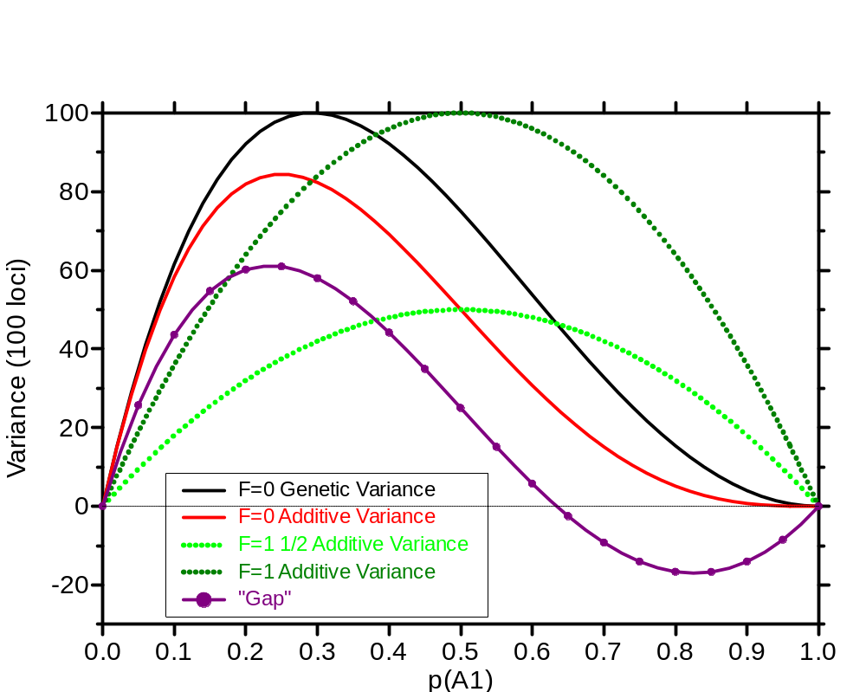
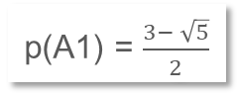
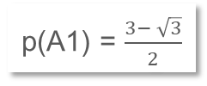
asdf
Compare again the Genetic Variance at F=0.0 and at F=1.0 (100 loci, a=d= 1) .
At F=1, half of the genetic vari-ance is between the S0-derived DH-bulks (or RIL-bulks) and half is within-all-these-bulks.
For Line Breeding, this informs us that choice of parents-to-be-crossed is half of the job, and exploitation the segregation from these crosses is the other half.
Here, we ask a different question.
►„What is the genetic variance that can be exploited at the level of F=0 (HWE) compared to what we can exploit at F=1 ? More specifically: What is it that we can not transfer (via BV∞) into the DH-bulks of crossed offspring of these HWE members“ ?
Genetic Variance at F=1
2σ²_{A}+4D₁+D₂* =
4pqa²
σ²∞(A)=2pqa²
p(A1) = $\frac{3− \sqrt{5}}{2}$
Genetic Variance
σ²∞(A)
p(A1) = $\frac{3− \sqrt{3}}{2}$
σ²∞(D) +2 ω∞(A;D)
40

Slide 41
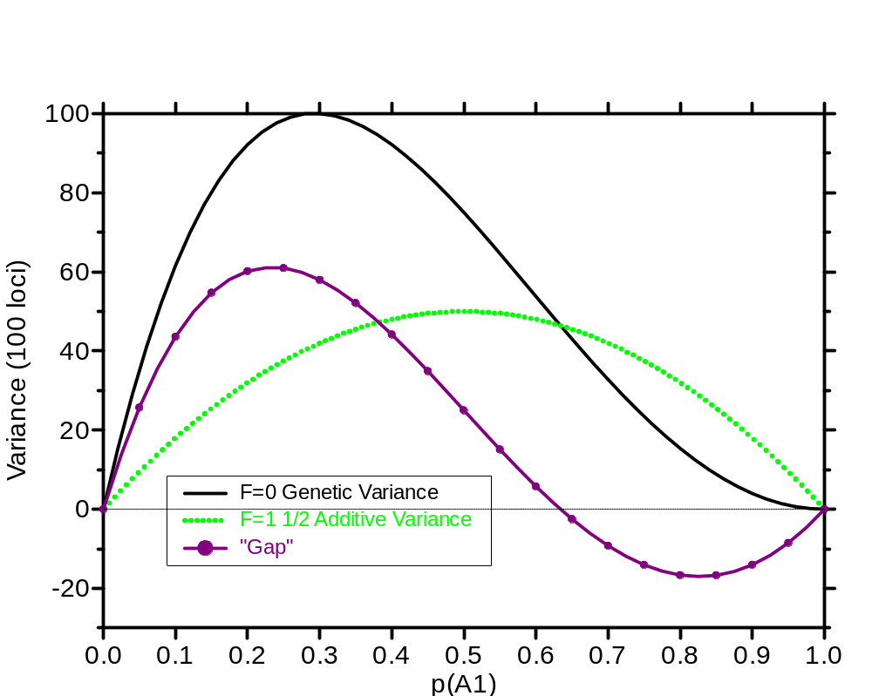
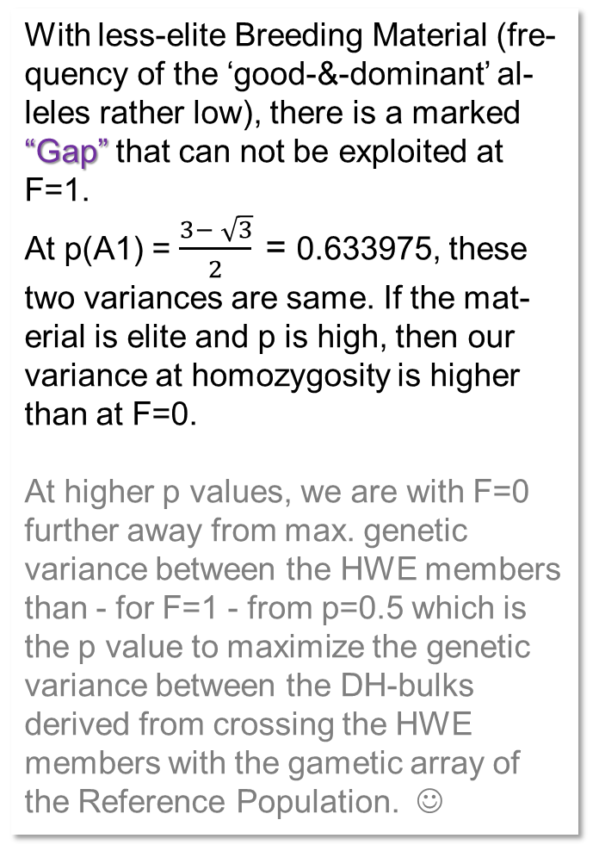
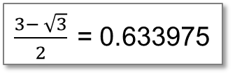
What is the genetic variance at F=0 and HWE compared to between our DH bulks ?
With less-elite Breeding Material (fre-quency of the ‘good-&-dominant’ al-leles rather low), there is a marked “Gap” that can not be exploited at F=1.
At p(A1) = $\frac{3− \sqrt{3}}{2} \text{= }$0.633975, these two variances are same. If the mat-erial is elite and p is high, then our variance at homozygosity is higher than at F=0.
At higher p values, we are with F=0 further away from max. genetic variance between the HWE members than - for F=1 - from p=0.5 which is the p value to maximize the genetic variance between the DH-bulks derived from crossing the HWE members with the gametic array of the Reference Population. ☺
100 loci,
a=d=1
$\frac{3− \sqrt{3}}{2} \text{= }$0.633975
σ²∞(D) +2 ω∞(A;D)
Var. of BV∞
41

Slide 42
What is the genetic variance at F=0 and HWE compared to between our DH bulks ?
Of course you may propose to not use our HWE members to check their BV∞ but to use all the homozygous lines that can be developed from our HWE population, and then check the BV∞ of these.
The variance between these then would be 2 ∙σ²∞(A) = 4pqa² . You saw this on page 18 as σ²_{G∞}=2σ²_{A}+4D₁+D₂*, and you have seen on page 25 that indeed :
2σ²_{A}+4D₁+D₂* =4pqa²
As seen, the genetic variance at F=1 is a symmetric curve if drawn on p(A1) as x-axis, and half of it is within all biparental crosses and half of is it between, whatever p(A1)-value.
100 loci,
a=d=1
$\frac{3− \sqrt{3}}{2} \text{= }$0.633975
σ²∞(D) +2 ω∞(A;D)
Var. of BV∞
42

Slide 43
Be clear that the variance of the Breeding Values of the candidates is not the variance between any kind of offspring of these candidates. Not between their Half-Sib offspring (F=0;S0); not between DH bulks (F=1) bred from such our candidates; not between DH bulks (F=1) bred from Half-sib offspring (F=0;S0) of our candidates (with the population as common parent). Although from time to time even myself, I tend to think like this, but: No. No. No!
The variance of the Breeding Values is just the variance of the Breeding Values which are features of the candidates (F=0; S0 individuals). G=µ+A+D+Epistasis. This variance is between the candidates themselves, and we typically assume the HWE-members (S0) to be the candidates – then the variance of the Breeding Values describes the Reference Population (HWE Population).
● Why is at F=1 the variance between S0-derived DH bulks exactly half the variance in the total ‘F=1 Population’?
This is because the S0-derived DH bulks ‘are’ averages of 2 gametes (the ones that made their S0 parent) and means of 2 have ½ the variance ..! That is the reason.
● Why is at F=1 the variance of the Breeding Values exactly half the genetic variance in the total F=1 population? This is because at F=1, the Genetic Values and the Breeding Values are the same. There is no dominance deviation at F=1 (candidates are homozygous and our Reference Population is at F=1, too). The genetic values of the S0-derived DH bulks are their Breeding Values for Line Breeding (their deviations from the µ of the Reference Population which is at F=1 show their Breeding merit as Effects). It is obvious, n’est-ce pas ;-) ?
σ²∞(A) = 2pqa² = σ²_{A} + 2D₁+ ½ D₂* = half the genetic variance at F=1.
One half is between the S0-derived DH bulks, the other half is within them.
“Our” dominance deviations in the pages before-here are not for homozygous genotypes but for the HWE-members (S0 individuals) which are asked to show their Breeding Values and Dominance Deviations for and from a Line Breeding perspective.

Slide 44
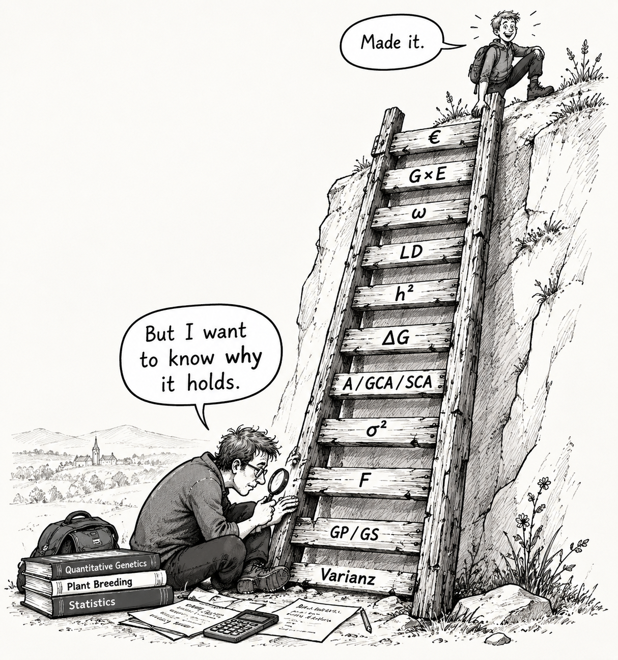
If you survived this nerdy chapter, then you may ….
from here you may go to UNPLAB-QuGen_Ch-11[QG Lines I] … which is again a more classical chapter.
44

